Slide 1
Night Photography
Stars and Such
Notes:
Before class set up:
AirServer and connect iPad to AnnieO
Arrange iPad, edge second screen
Open PowerPoint, and show presentation in Presenter View
Share second screen
Take a deep breath
Hey everyone…
I’m happy to be able to share a little more information about night photography and flesh out what Shari Hunt did during our meeting. I haven’t had a chance to do as much night shooting as I would like, but I do enjoy it, and I’m pleased to be able to share some tips with you.

Slide 2
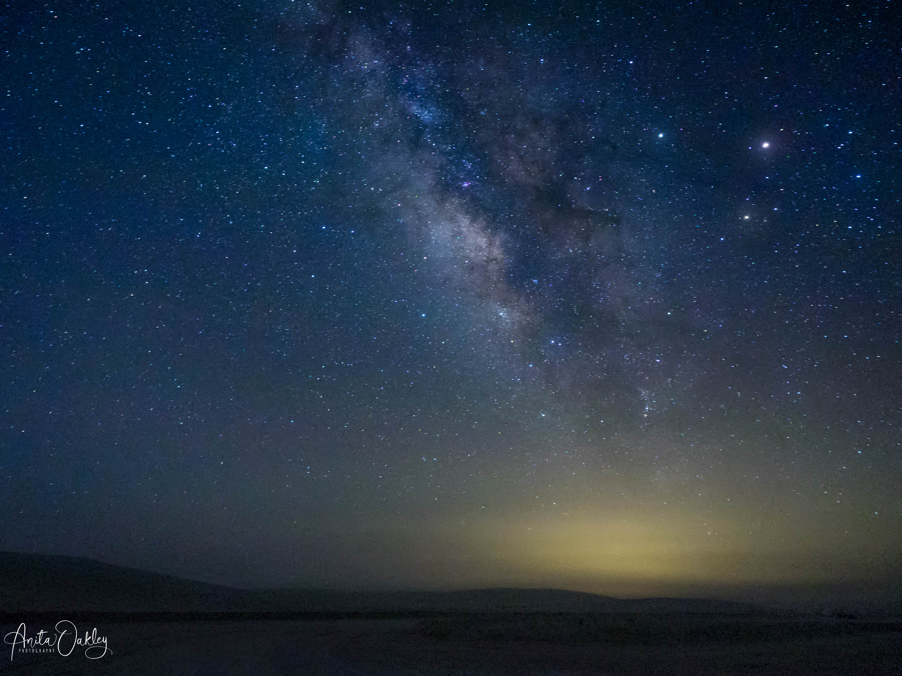
Intro
My background
A good star shot takes a lot of planning
Use several tools to prepare
Consider going with a leader once or twice
  Workshops and meetups
  Find a mentor?
So let’s dig in!
Notes:
Hi everyone,
My first star shots were taken on a trip to White Sands, where we had permission to enter the park before dawn. We were hanging out at the entrance waiting for the ranger to open the gate, and Elisabeth Shore said, “Let’s try some Milky Way shots.” She had just learned a little bit about shooting at night and was able to give me a starting place for the settings. This image was my very first Milky Way picture, and I was hooked.
Then on a trip to South Georgia Island, I made friends with Jen Wu, who is a Canon Explorer of Light, and an expert in the field. She came to speak for the Heard photo club, and taught me a bit more, and I picked up a copy of her field guide for shooting after dark. A couple of workshops with Mike Mezeul gave me more hands-on experience, too.
So, on to tonight's class.
Night photography isn’t all about the Milky Way, or even about stars. It encompasses car trails, cityscapes, factories and bridges, and all manner of subjects. I love rainy city street at night, for instance, but tonight we are going to concentrate on the stars. We will talk a lot about Milky Way, and a little bit about star trails, too.
A good star shot takes a lot of planning. A nice way to ease into it is to go on a workshop or meetup with a leader who can help you. But we’re going to talk about how to plan, shoot, and edit Milky Way shots from start to finish.
You can do a lot of that planning in your living room or office… All it takes is a computer.
Unfortunately, there is no one site or app that does it all. We can combine the available tools, though, and do a great job planning and executing a shot. So let’s dig in!

Slide 3
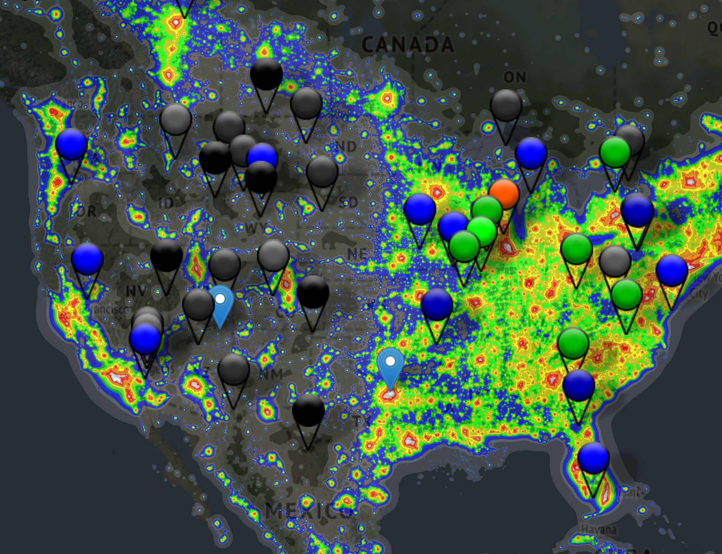
Prep: Internet Searches
https://www.darkskyfinder.com
Notes:
A lot depends on whether you have a trip planned to a particular area or are just looking for a good location and don’t know where you want to go. If it’s the latter, start by looking for dark sky areas and see what tickles your fancy.
There are multiple websites, but darkskyfinder.com has a great light pollution map. Just be careful what you click on – if you click start, you are downloading Chrome. Click on “Open Map.”
As you can see, the eastern part of the US is has a lot of light pollution, but there are a few marked locations where you have a chance to see stars.
The western half of the US is great until you get to the west coast, where there is a higher population. Still, right along the coastline there’s a border where you can shoot out over the ocean and the skies will be really dark.
But perhaps you have a trip planned to somewhere in the globe and want to shoot stars while you are there. You can also check out Dark Sky Finder to see what skies that area provides.

Slide 4
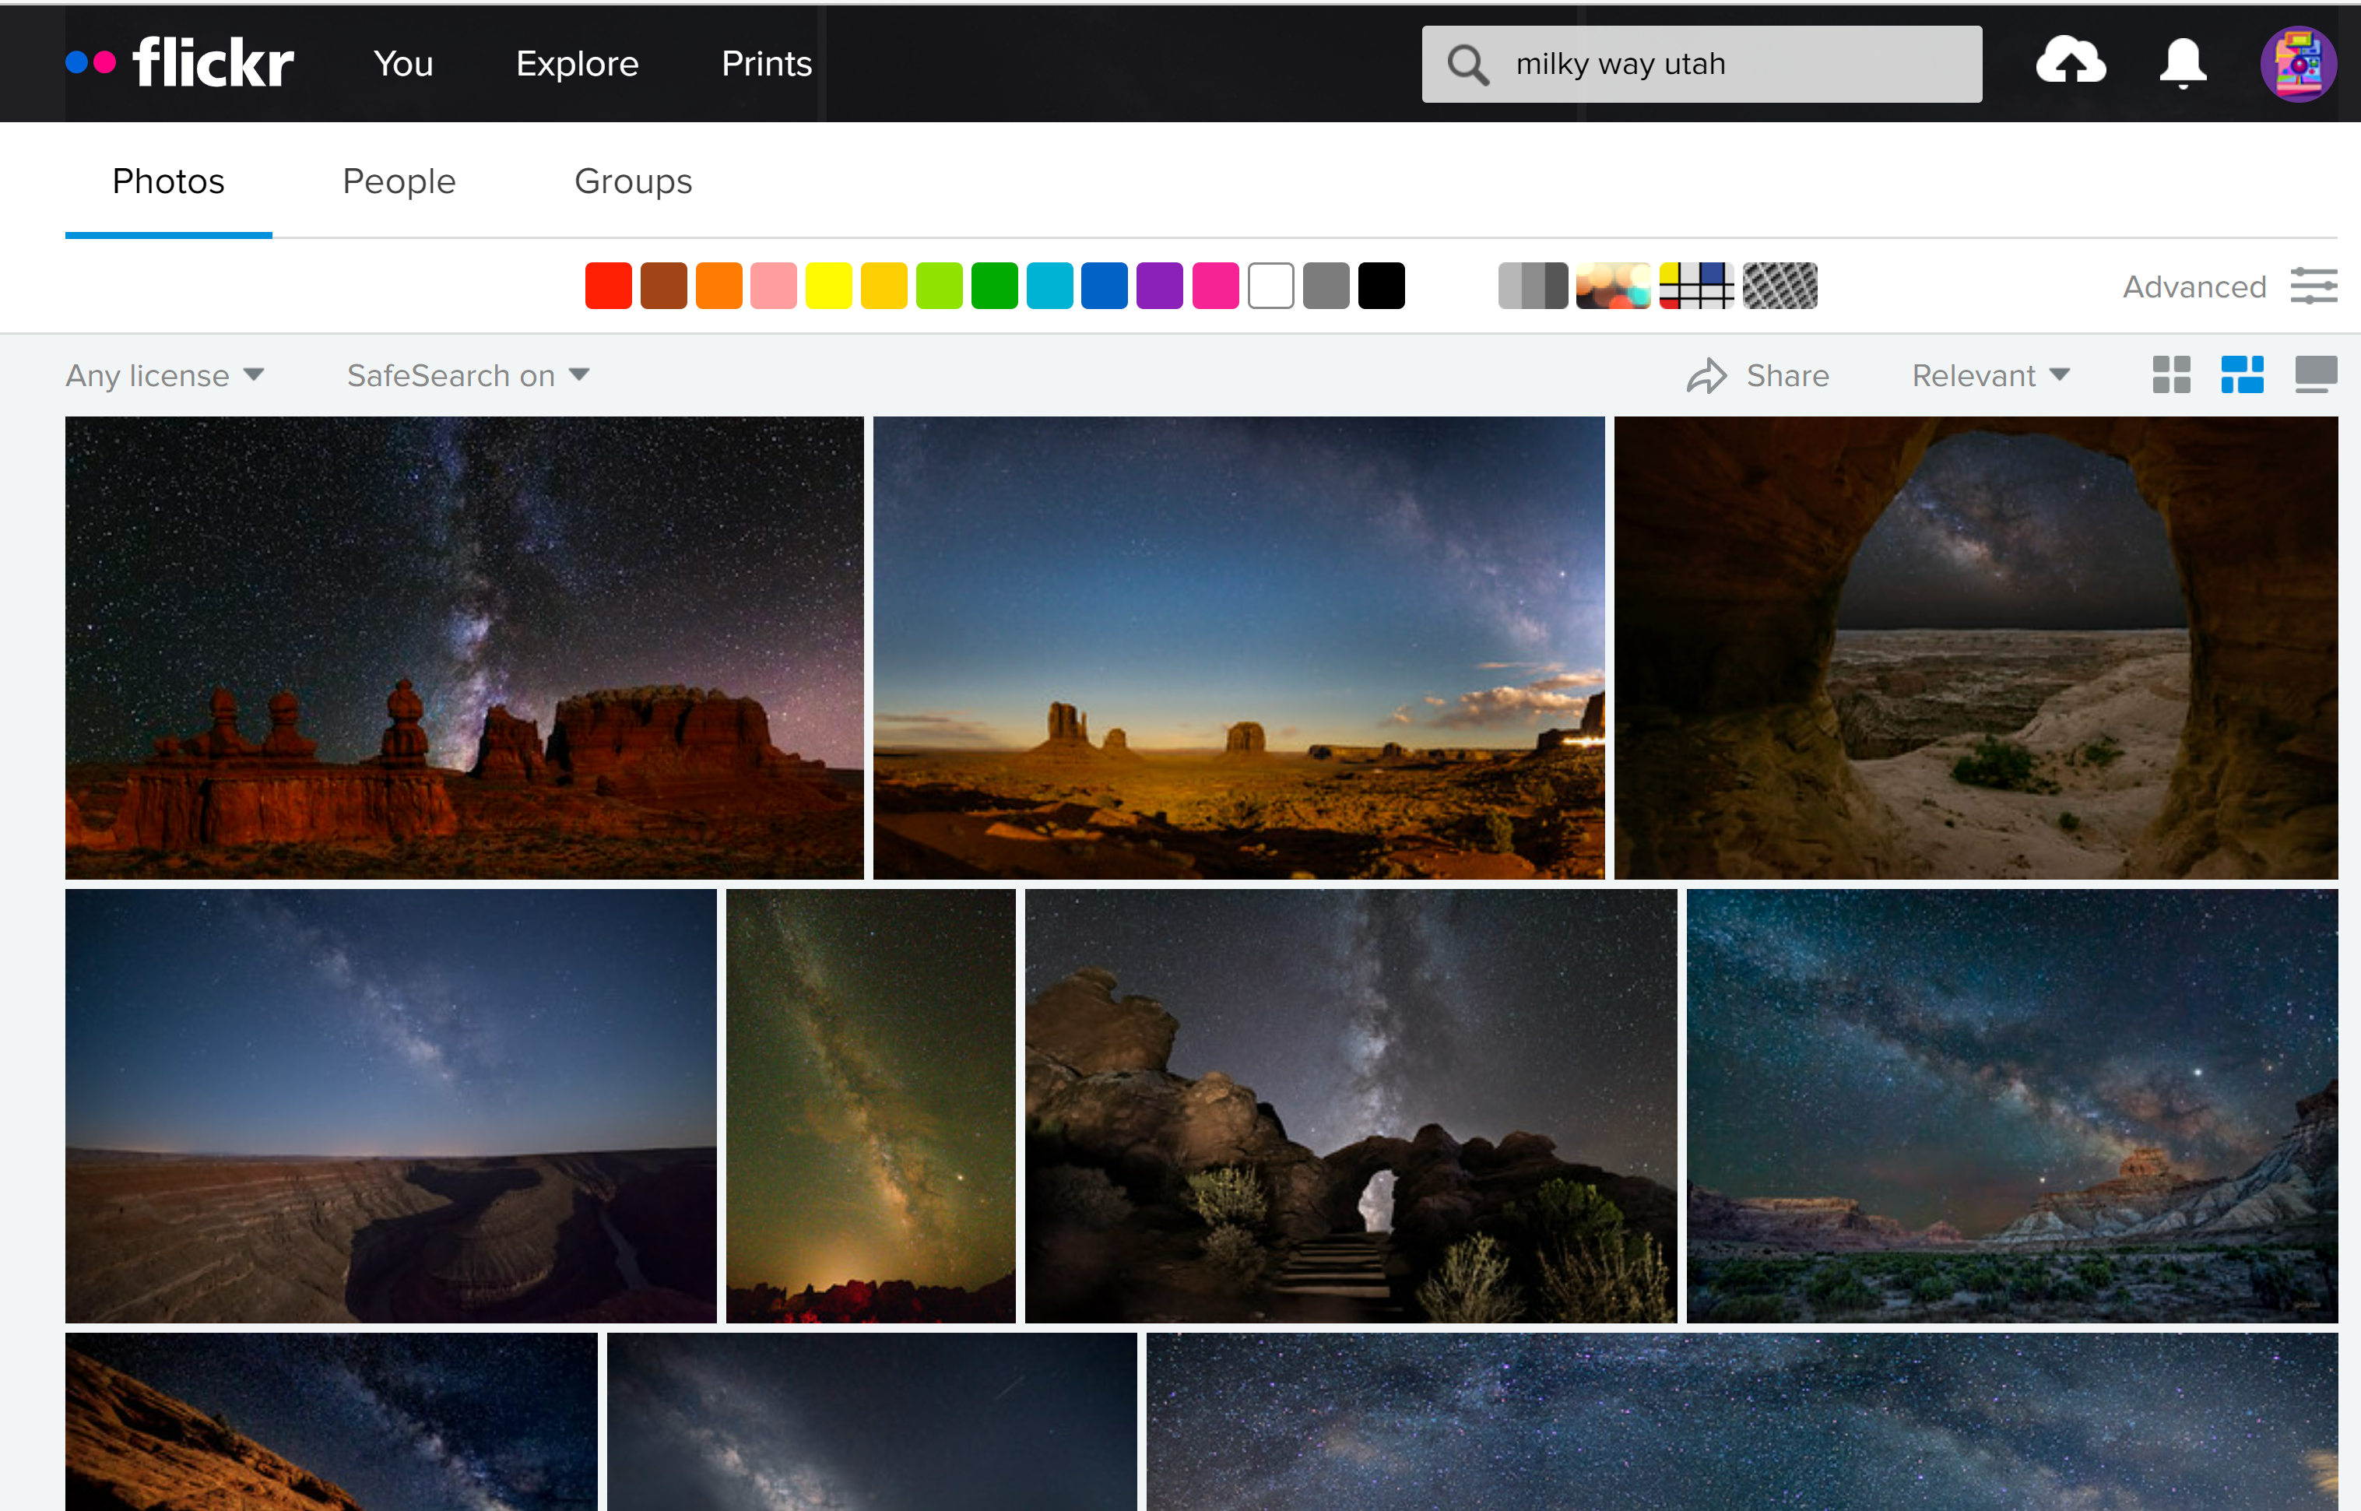
Prep: Internet Searches
Instagram? Not so much – try Flickr or Photohound.
Query: Milky Way (location)
Notes:
Once you know where you want to go, see what’s available in your target area for foreground interest. Sometimes you get lucky and know an area well enough to have an idea where you want to go, but if not, query for points of interest and see if you find images online including the night sky. Remember – The object is not to duplicate other photographers’ work, but to find a great spot and put your own spin on it.
Instagram has been overtaken by a lot of people who overprocess images and warp the landscapes. Try Flickr for more realistic images and descriptions of the subjects. PhotoHound isn’t as comprehensive, but it’s made for photographers by photographers, and if you find a spot there it will come with good descriptions and tips.
Just to save you a little time, here are some likely spots in Texas:
Big Bend is THE premier location. Most areas in the NP are among the darkest skies in the US
McDonald Observatory is only slightly less dark than Big Bend NP.
Palo Duro Canyon is a little less dark than McDonald Observatory.
In each case, the territory south and east of the park doesn’t have a high population, so light pollution is at a minimum. This is important. At the Hagerman National Wildlife Preserve, the skies are pretty dark, but to the south, the entire DFW metroplex causes all kinds of trouble. It’s great for star trails, but not for Milky Way.
Other good options include:
Matagorda Island.
Brazos Bend State Park.
Enchanted Rock.
Canyon of the Eagles Resort.
Dripping Springs.
Say we want to shoot Milky Way in Utah. You query on Flickr and get a bunch of possible locations.
(Next slide)

Slide 5
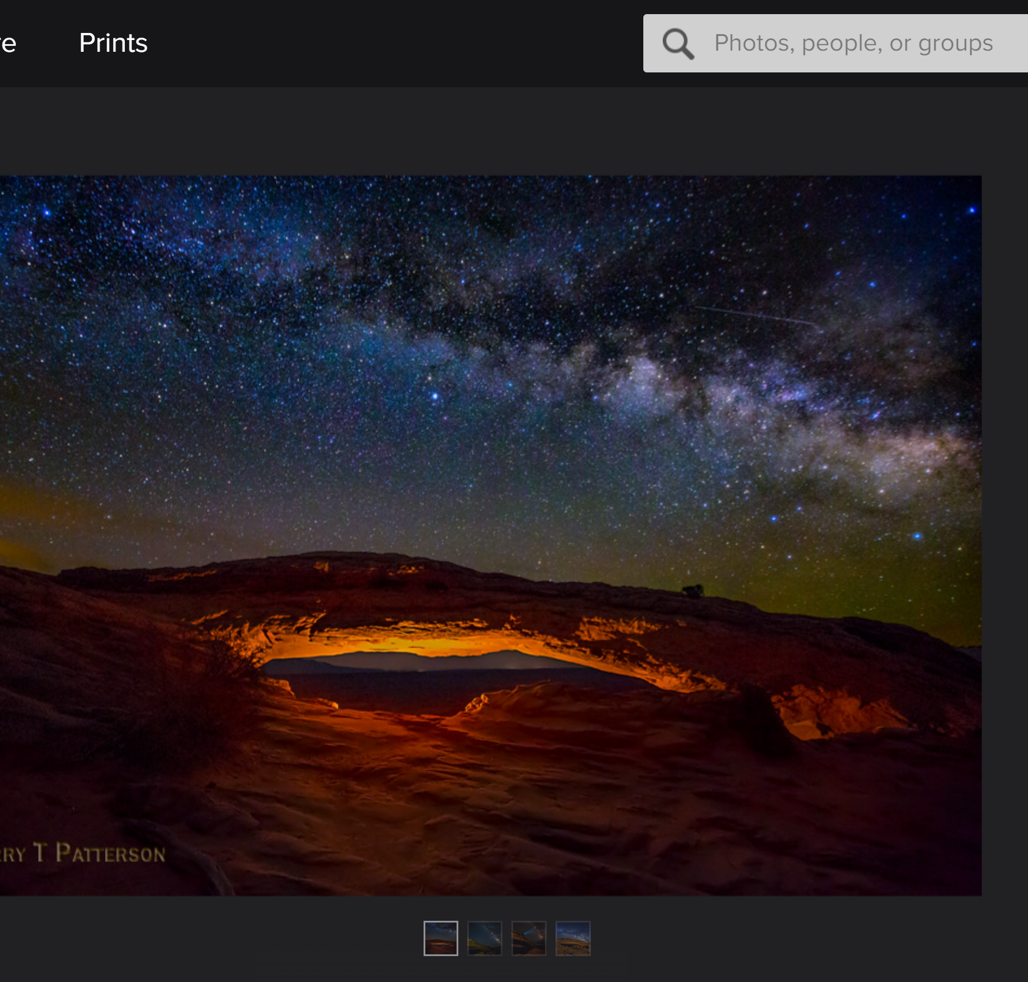
Prep: Flickr Search – Milky Way Mesa Arch
Credit Jerry Patterson
Notes:
This looks good… Maybe it would be a likely place to try our hand. We’re going to pretend we don’t know that this is Mesa Arch.
Frequently you can get valuable information in the text under the pictures – for instance, Jerry Patterson posted the location, and noted that this was taken the 2nd week of March in 2018, and that he used Low Level LED panels under the arch to light it. So, if you want the Milky Way low over the arch, try in March or April.

Slide 6
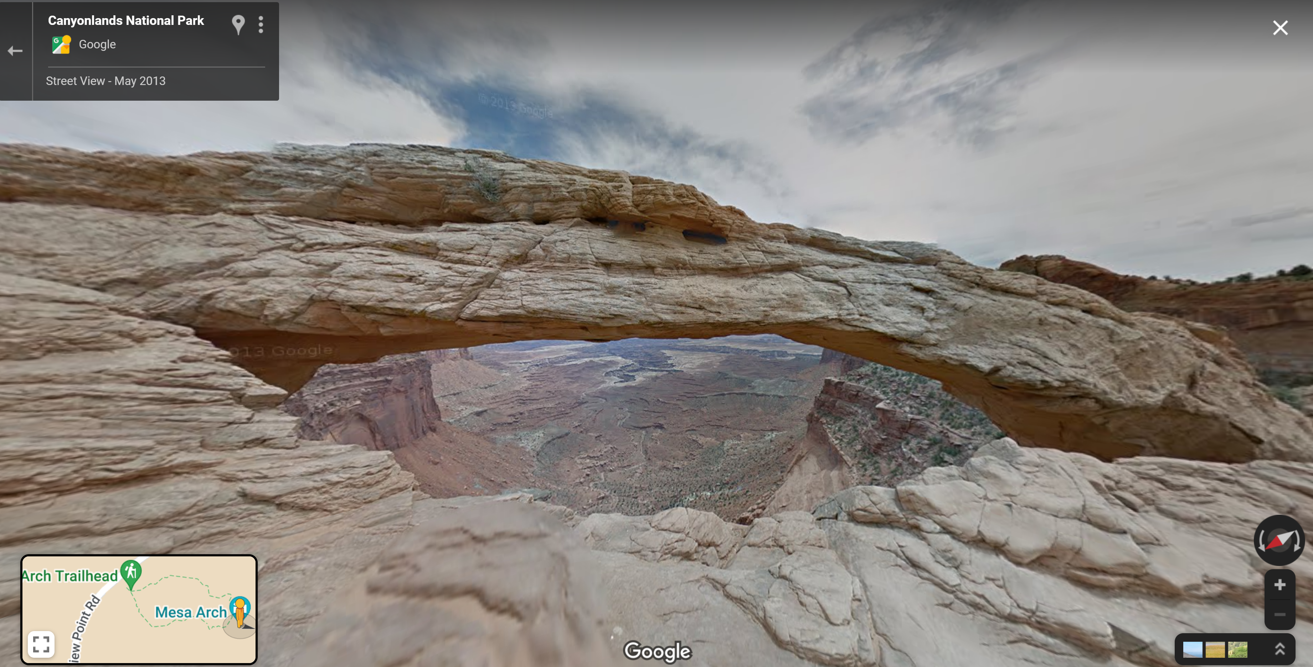
Prep: Google Maps With Street View
Notes:
In Google Maps search on your target location.
Street View may let you see the lay of the land and help with camera placement.
This is looking east/southeast. You can see that by the compass on the right. You know the galactic center will be more to the south, but the arch of the Milky Way goes all the way to the north. Perfect!

Slide 7
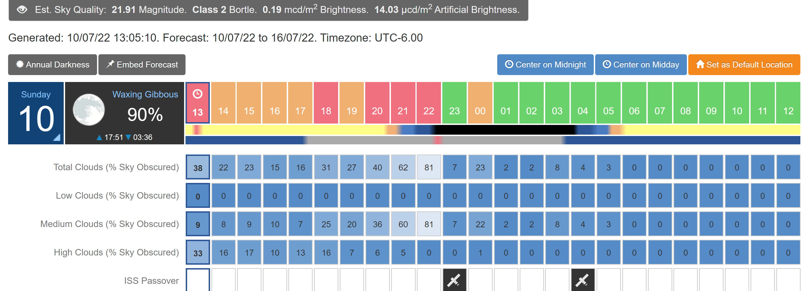
Clear Outside Gives You the Bortle Rating
Notes:
If you want a quantitative rating for dark skies in your target area, check Clear Outside. Clear Outside is available as an app for your phone, and on the web at clearoutside.com
It gives you the Bortle rating for any location in the world. The Bortle rating is the international standard for light pollution. Bortle class 1 is darkest, with 9 the brightest.
One warning: the stupid thing defaults to Exeter, Devon, UK every time, but you can save your preferred locations. Just be aware that you must reselect them when you restart the app. I can’t tell you how many times I’ve looked at Exeter instead of my target area, and then slapped my forehead.

Slide 8
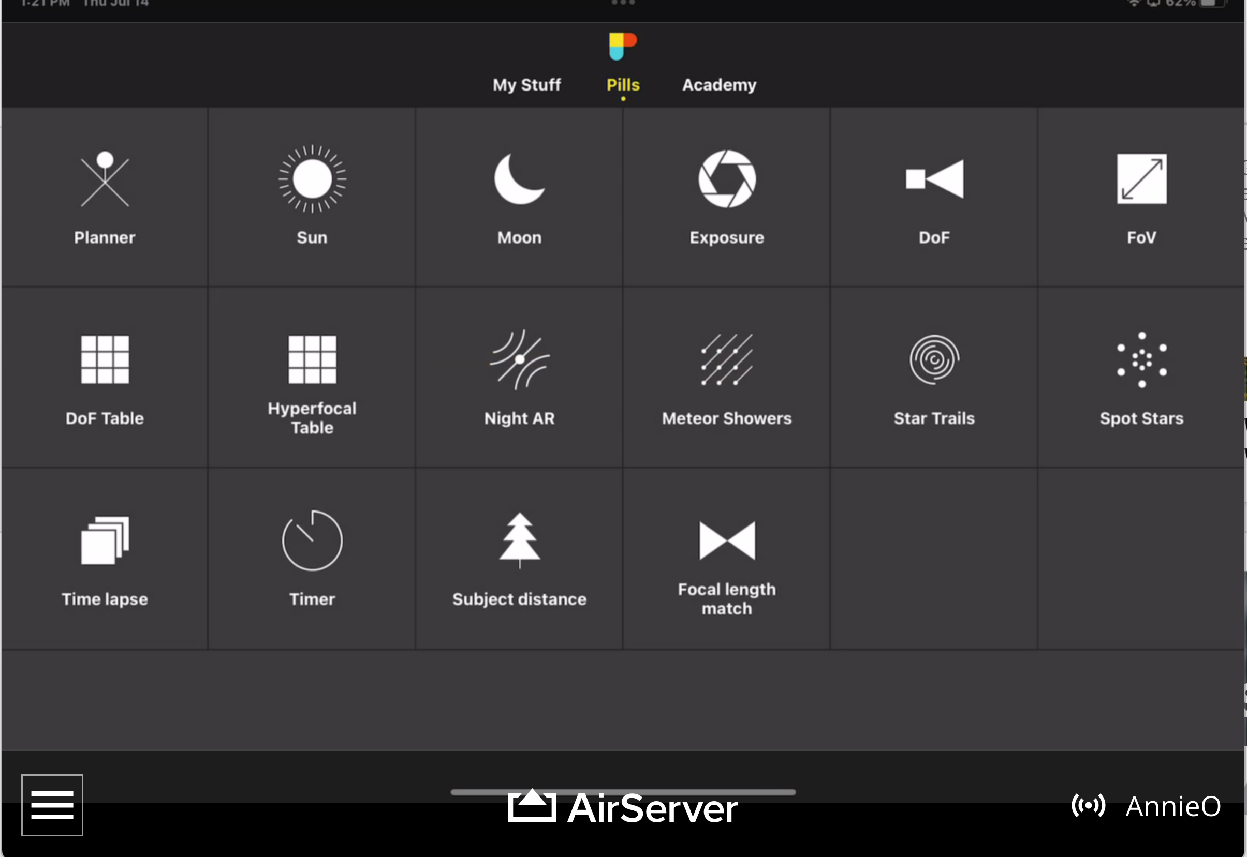
Prep: PhotoPills
The Pills – Give you moon phases, Sun, Moon, and Milky Way rise and Set and much more
The Planner – Wonderful, wonderful tool. Learn to use it on YouTube. Look for PhotoPills Friday!
Notes:
There are some great tools to use when planning shoots. The Photographer’s Ephemeris is great for sunrise and sunset, but I’ve fount that PhotoPills is best for Milky Way. It is interactive and the graphics just make more sense to me. Using these tools you go into the shoot with a much better chance of success.
The Pills give you moon phases, Sun, Moon, and Milky Way rise and Set times. There are pills for just about any area of photography. Need to find the hyperfocal length for your camera and lens? Check the depth of field? It’s there.
When you go for Milky Way, choose your moon phase wisely – The Milky Way will be brightest at the New Moon but a crescent moon can light the landscape a bit. It’s a balancing act.
The time of year is a huge consideration. The Milky Way is up in predawn hours earlier in the year, progressively earlier during the summer, and before midnight in the fall.
It’s a low arch in spring, vertical in fall. You want to take the orientation of the Milky Way into account. Some locations look better with the arch, others with a vertical galaxy.
The Planner – When I first started using PhotoPills, I opened the planner, couldn’t figure it out, gave up, and went back to using the other pills. But Planner is a wonderful, wonderful tool. You can find just the right viewpoint, know where the Sun, Moon, and Milky Way rise and set, what height they will be, at any given date or time of day. You can even search for the day and time when the sun or moon is exactly where you need them for a shoot. Then you can save your plan and load it back up later.
I will go into PhotoPills for planning a Milky Way shot in more depth soon, but you can learn to use it on YouTube. Look for “PhotoPills Friday!” It’s a series of more than 20 videos that teach you all about PhotoPills.

Slide 9
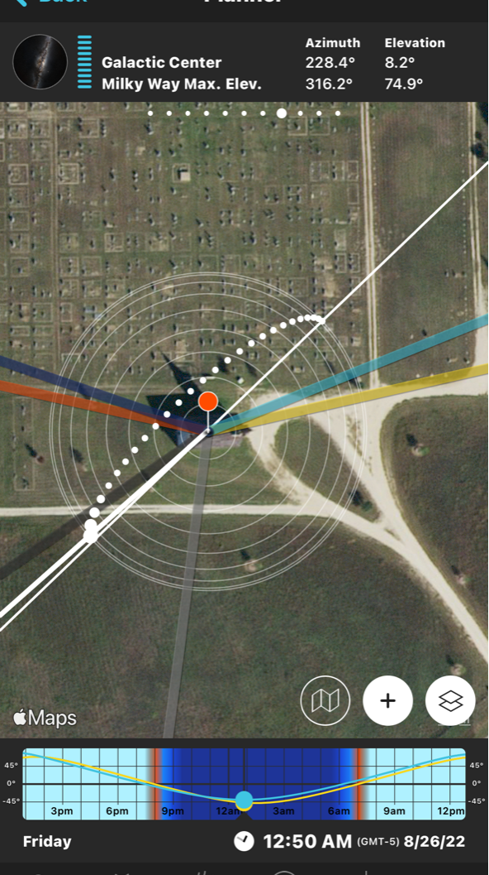
The Planner
Notes:
The concentric circles show the height of the arch. The farther from the center the middle of the arch is, the lower the arch.
Think of it like a Bosu ball – one of those balance training things. The horizon is at the edges of the ball, and the high point in the center represents the sky over your head. The circle on the planner is in effect a flattened Bosu ball.
The arch shows the orientation of the milky way.
The biggest dot represents the galactic center.
The light grey line shows direction of the rise of the galactic center.
Dark grey line shows the direction of the set of the galactic center.
The thin white line shows the start and end of the arch.
The heavy white line shows the direction of the core.
Point out the Milky Way panel at the top. It shows the time the galactic center rises and sets, how high it will be and the azimuth (direction).
Point out the timeline, and mention how you can scroll through time.
You can tap the panel icon to skip ahead to the next new moon. Double-tap to go to the previous.

Slide 10
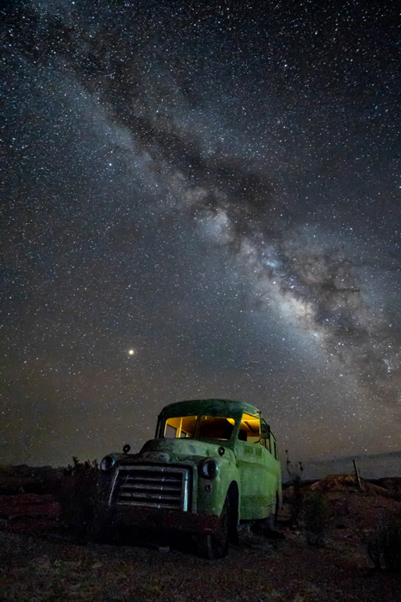
Let’s Plan!
(Demo)
Notes:
Let’s take a look at the planning process
You have seen some great images of the Milky way over Big Bend National Park, and want to shoot your own.
Search for a spot on Flickr – Milky Way Big Bend National Park
Pick the image from Santa Elena
Show the text below and mention that sometimes you can use Google Image Search if the text doesn’t tell you where the image was taken.
Check out Google Maps for accessibility.
Show pegman to see where you can position yourself
Show the planner.
Set the planner to show only the Milky Way layers
Load Santa Elena Canyon
Look at new moon in October, skip ahead, skip back…
Note, the galactic center isn’t quite visible, and isn’t visible at any time this fall. But it would still be a good shot.

Slide 11
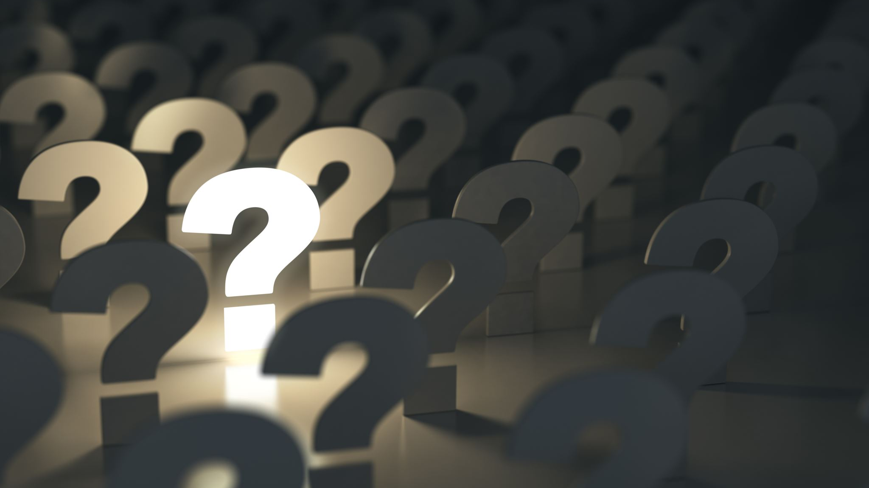
Questions so far?

Slide 12
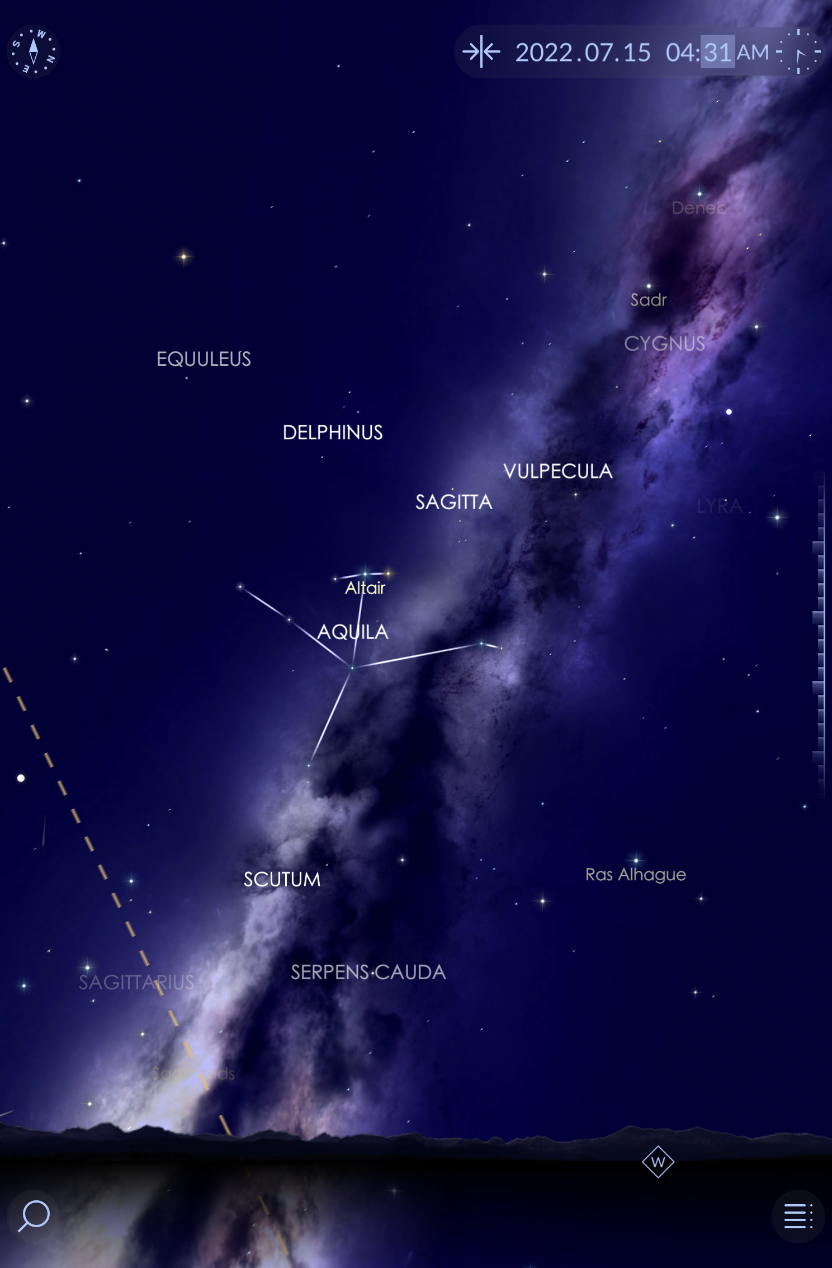
Prep: Scouting Tips
Scout! Could be months ahead or during your trip. Go a day or two early.
  Use Star Walk II to see where the Milky Way will come up at night.
  Look for foreground elements.
  Don’t trespass!
Notes:
Getting out to your target area and looking for foreground at the last minute could be disastrous. Imagine yourself stumbling around in the dark trying to find a good composition. Lesson learned? Scout before dark! If your target is close to home, you can go out there anytime beforehand. If your target area is distant, consider going a day or two early to scout.
Look for foreground elements. Keep in mind that shapes are harder to incorporate at night.
Without some kind of light, the only shapes you will see are those silhouetted against the sky.
You can use Star Walk 2 or PhotoPills to see where and when the Milky Way will come up on any given day, and what it will look like on that date. Augmented Reality will put the Milky Way into the landscape for you. Both PhotoPills and Star Walk have AR, but I prefer Star Walk 2 for that. It just seems easier to use.
A word of warning, don’t trespass! Private property is off limits unless you have permission. I’ll bet you either have a horror story about irate landowners or you know someone who does. I have friends who have been threatened with guns while they were out shooting. Contact landowners if you need access. They may even be willing to turn off lights that would interfere with your shot. Offer them a print – most people are nice if they feel that you will respect them and their property.
Fortunately, it’s not too hard to find out who owns a piece of land. Go to the county tax assessor’s office, visit the local land recorder or county clerk, or contact a local title company. If all else fails, reach out to mailing list companies & brokers.

Slide 13
Prep: Clear Outside Gives You Cloud Cover Info
Notes:
It helps to know if you will even be able to see the stars. The night before and the day of your shoot consult Clear Outside again to see what the cloud cover and visibility will be at any given hour of the day. It’s remarkably accurate, especially on the same day.
Just a little confession on my part… When Mary Ruehle and I went out to the ghost town by Ft. Griffin, I checked the cloud cover. The Galactic Center was supposed to be visible starting around 10:00, and the cloud cover was supposed to clear between 10 and 11:00. All well and good. Everything happened as advertised, but I forgot to check visibility. As it turns out, there were grass fires in West Texas, and the smoke blew into the Albany area. We still got some nice images, but they weren’t as good as others I’ve captured out there when the sky was clearer.

Slide 14
What to Bring?
Stuff to bring:
  A good headlamp or bright flashlight
  Hand warmers
  A hat to keep your head warm
  Tripod
  Remote release
  First aid kit
  Bug repellant
  Snacks and caffeinated drinks
Notes:
Stuff to bring:
A good headlamp or a bright flashlight – for hiking. Remember, you may go out to your location during the day, but you have to come back at night.
Hand warmers – unless it’s summer and hot.
If it’s cold out – a warm hat and photo gloves
Tripod - duh. Consider a little glow in the dark tape on the legs.
Remote release, but if you don’t have one you can use a 2 second delay. I like to use my electronic shutter to avoid any shake at all.
First aid kit just in case
Bug repellant especially in summer
Snacks and caffeinated drinks – it gets late out there!

Slide 15
Prep: Last words
Be able to use your camera without looking at it!
Practice in the dark at home
Practice focusing at night on pinpoint lights
Notes:
It’s important to be able to use your camera by feel. Turn out the lights and practice at home. Be able to change your ISO, aperture, shutter speed, and focus without lights. It’s important to practice in horizontal and vertical orientation.
You also need to be able to focus properly. More about that later, but practice before you go!

Slide 16
Questions on Prep?

Slide 17
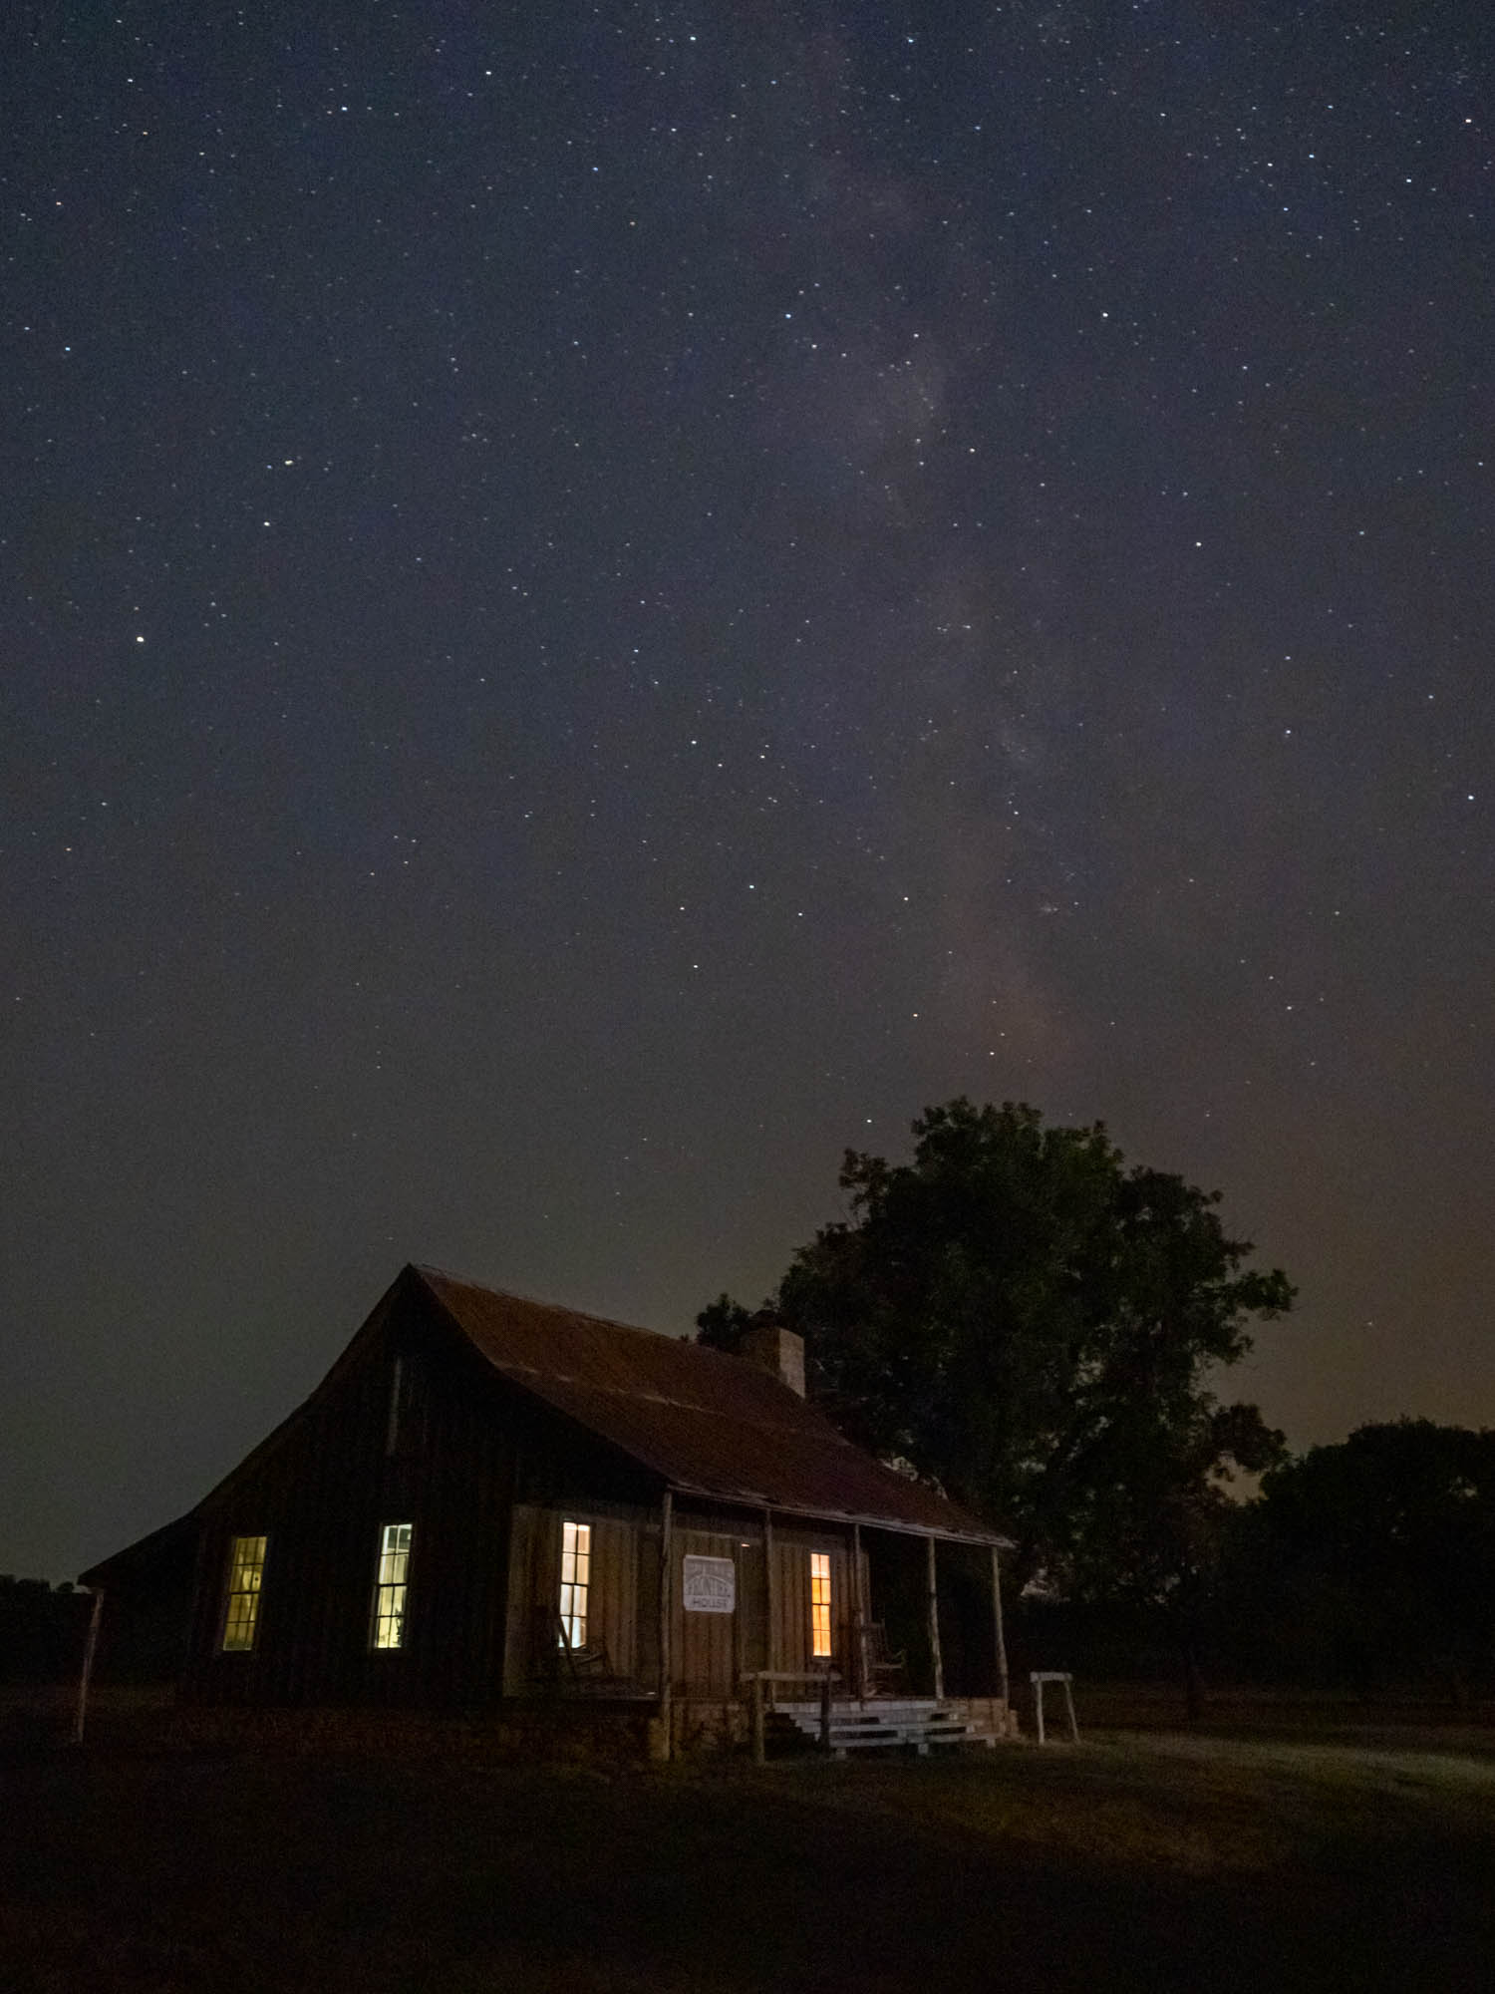
On Site
Be prepared to be underwhelmed if you have seen wonderful Milky Way pictures but not the Milky Way with the naked eye.
Notes:
Next, lets talk about the actual shoot.
When you get onsite, and it gets dark be prepared to be underwhelmed if you have never seen the Milky Way in person. It doesn’t look at all like the brilliant colorful pictures you have seen. Instead, it’s a milky looking streak across the sky. All the stars are impressive, but don’t expect to see something like the images you have seen in books and on the web.

Slide 18
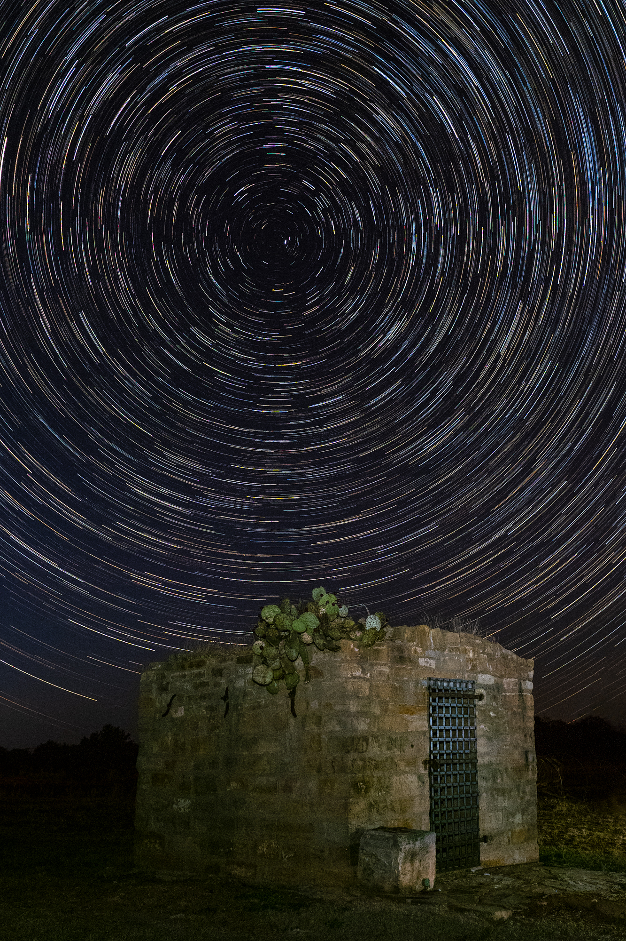
Decisions, Decisions…
Decision – Single shot or stacking
Two bodies? Try Star trails with one, Milky Way with the other
Use your electronic shutter to eliminate any shake
Notes:
When you get onsite you need to make some decisions. Are you going to do a single shot or take several and stack them?
Single shots are faster, and much less work in post. You can usually manage noise with DeNoise AI, particularly if you have a newish full frame camera.
Stacking gives you the ability to shoot very short shutter speeds at high ISO and still have almost no noise.
If you have two bodies, you might try shooting star trails with one and the Milky Way with the other. For Star Trails, you could open the shutter and shoot a very long shutter speed, but that causes a LOT of noise. Instead use an intervalometer and stack the images in post. Or if you have an Olympus, use Live Composite and just let it go, and it does the stacking for you.
Once you set up your star trails, you simply ignore your camera for a long time. You might as well be doing the more labor-intensive Milky Way shots. But caution – have your star trails setup far enough away from the Milky Way location so that you don’t get light bleed from the times you turn on your headlamp.

Slide 19
Camera Settings
Go manual all the way
Camera Settings – Single shot
  Fast Lens – at least f/2.8
  Starting place: 25 seconds, ISO 2000, wide open. Increase ISO as needed.
  The 500 rule fails with most cameras. PhotoPills has a pill for pinpoint stars – dependent on focal length, camera, f/stop.
  Noise Reduction off until everything is set, then on for the final shot
Notes:
For both single shot and stacking shoot RAW and in manual mode! Set your white balance to 3600 - 3800 Kelvin. If your camera doesn’t have Kelvin settings, set it to daylight so that all images will have the same white balance setting.
Your camera settings will depend on your approach. If you plan a single shot:
Use a fast Lens – at least f/2.8.
Wide angle will give you the broad sweep of the Milky Way, plus you can leave the shutter open longer without getting trails.
A good starting place, 25 seconds, ISO 2000, wide open. Increase ISO as needed. Depending on your location the ambient light will dictate different exposures. Note, this will probably not give you pinpoint stars, but unless you are going to print large it’ll hardly be noticeable.
Leave Noise Reduction off while you do some test shots to get the exposure, compensation and focus right. Then turn it on for the final shot. Otherwise, you have to wait 25 seconds after the shutter closes before you can do anything else for each test shot.
Pinpoint stars are dependent on focal length, camera, and f/stop. You may be familiar with the old 500 rule - 500 / Crop-Factor x Focal Length = Ideal Shutter Speed. This rule was devised for film with grain, and it should be used only as a rough guideline for Today’s cameras. A better option is to use PhotoPills, which has a pill to take the guesswork out of that.

Slide 20
Camera Settings
Camera Settings – Stacking
  Shorter shutter speeds. 6-12 seconds
  Crank up the ISO
  Take 8-15 shots in succession
  Noise reduction off
  Stack in post
Notes:
If you plan a stacked shot, your camera settings will be quite different.
Shorter shutter speeds. 8-12 seconds
Crank up the ISO
Take 8-20 shots in succession. Most modern cameras can be set up to do this automatically on time lapse or interval shooting
Noise reduction off
Stack in post.
You can get away with exposing more brightly when stacking because the noise will be removed in post. This works because the stacking technique makes use of the random nature of noise. By making a series of images without moving the camera, every single image will have a slightly different noise pattern. When combining these images in a smart way, it is possible to cancel out the noise, without loss of detail.

Slide 21
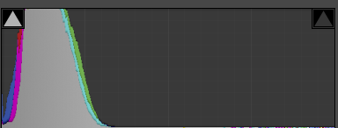
Exposure
Do not rely on the LCD – it’s way too easy to underexpose badly.
Check the histogram. Try to expose so that the peak is about a quarter to a third over.
Experiment
Notes:
When I first started shooting Milky Way, I got all excited looking at the back of my camera, but on the computer screen everything was way too dark. Do not rely on the LCD – too easy to underexpose badly because your eyes are adapted to the dark. When you get home you will be sorely disappointed.
Check the histogram. Try to expose so that the peak is about a third of the way over. Keep in mind that you may clip on the dark side if you have silhouetted portions of the composition. That’s ok.
Experiment – all cameras are different. All locations are different.

Slide 22
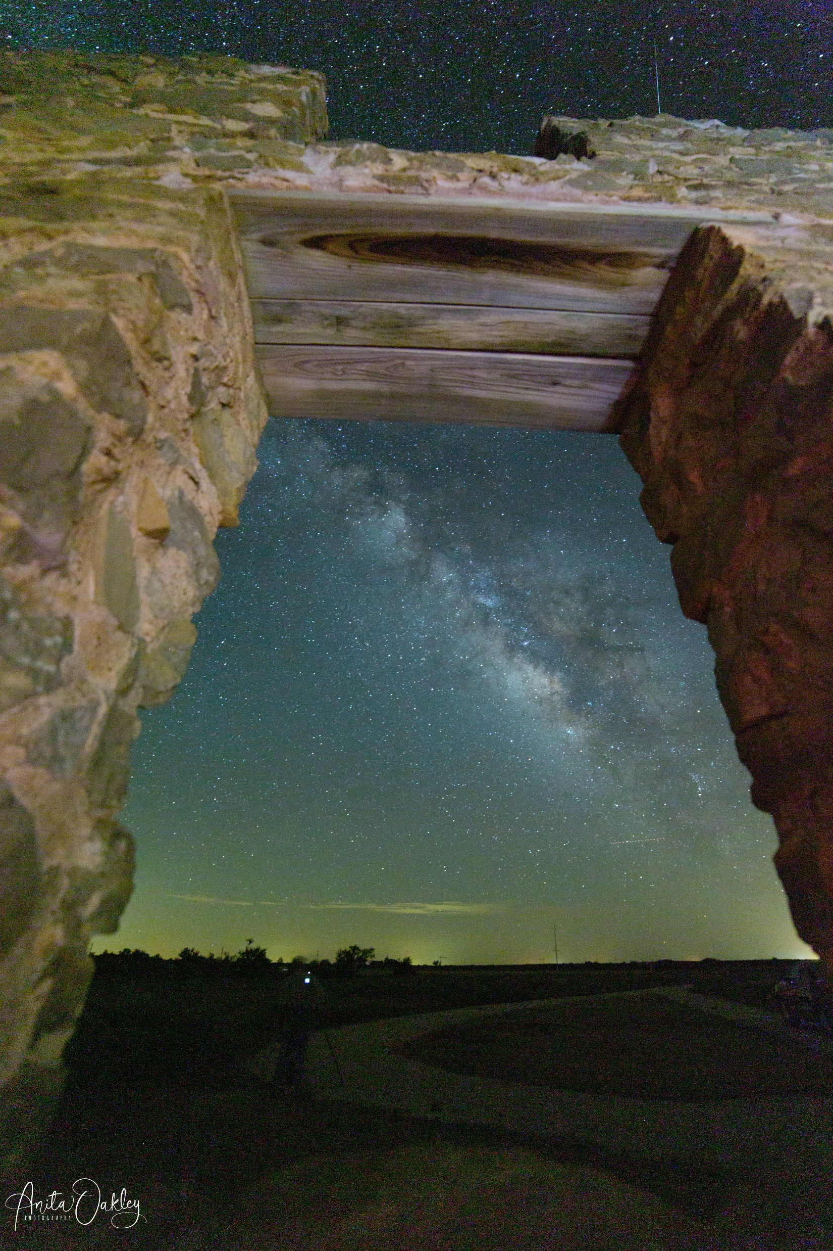
Focusing
Focus depends on your main subject
  Broad Landscape?
  Buildings?
Notes:
There are two schools of thought on focusing. One is to focus on the stars, and let the foreground take care of itself. The other is to focus on your foreground subject and rely on hyperfocal length to get acceptable stars. You can also focus stack if shooting a very close foreground.
If you are doing a broad landscape, focus on the stars. On most cameras, it’s just shy of infinity. That’s because camera manufacturers build in a little leeway to compensate for temperature fluctuations changing the distance between lens elements. Focusing at night is tough. Your camera probably has a feature to enlarge the subjects in Live View. Put a bright star in the center of the frame and focus until it appears at its smallest. Some Olympus users have starry sky autofocus. At night you can focus on a light in the distance.
If you have a particular foreground interest, try focusing on that. The Milky Way may be slightly out of focus, but it probably will be acceptable. Why? Remember hyperfocal length? On my camera, at 14mm and f/2.8, my hyperfocal length is 15 feet. Chances are any buildings I may be using for foreground are more than 15 feet away. If you want to focus during the day, you might bring some tape to secure your focus ring in place. But if you move your camera, remember to adjust your focus.

Slide 23
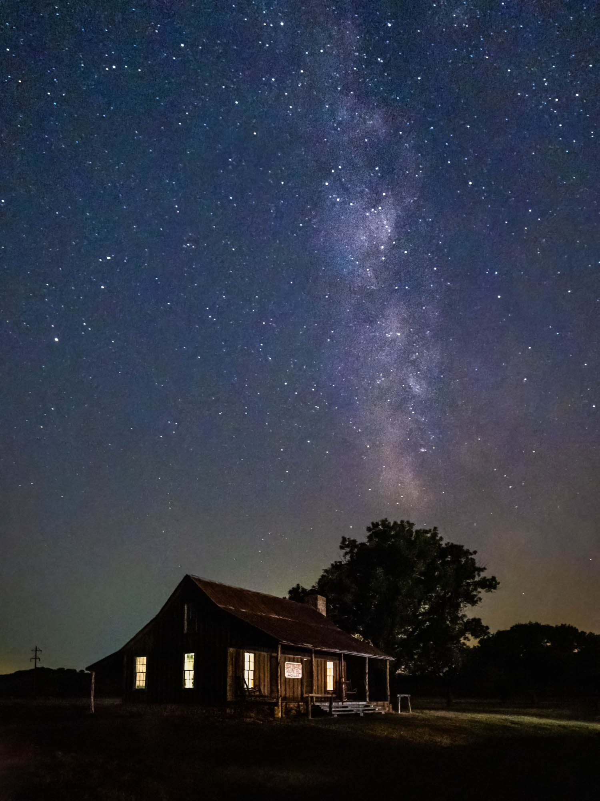
Framing
All the usual considerations
  May have night sky boost to help with composition
  Horizontal or vertical – try both.
  The Milky Way never changes, the foreground makes your image unique.
  Lighting – keep it natural
  If you have no moon at all, try shooting your foreground during Blue Hour.
  Vary your focal length.
Notes:
When it comes to framing, composition is composition. All the usual considerations apply.
Your camera may have night view boost to help
Shoot horizontal or vertical? Try both.
Vary your focal length.
The Milky Way never changes, the foreground makes your image unique.
Lighting – keep it natural
If you have no moon at all, try shooting your foreground during Blue Hour.
If you have buildings, shoot wide and leave room to use transform to correct perspective distortion.

Slide 24
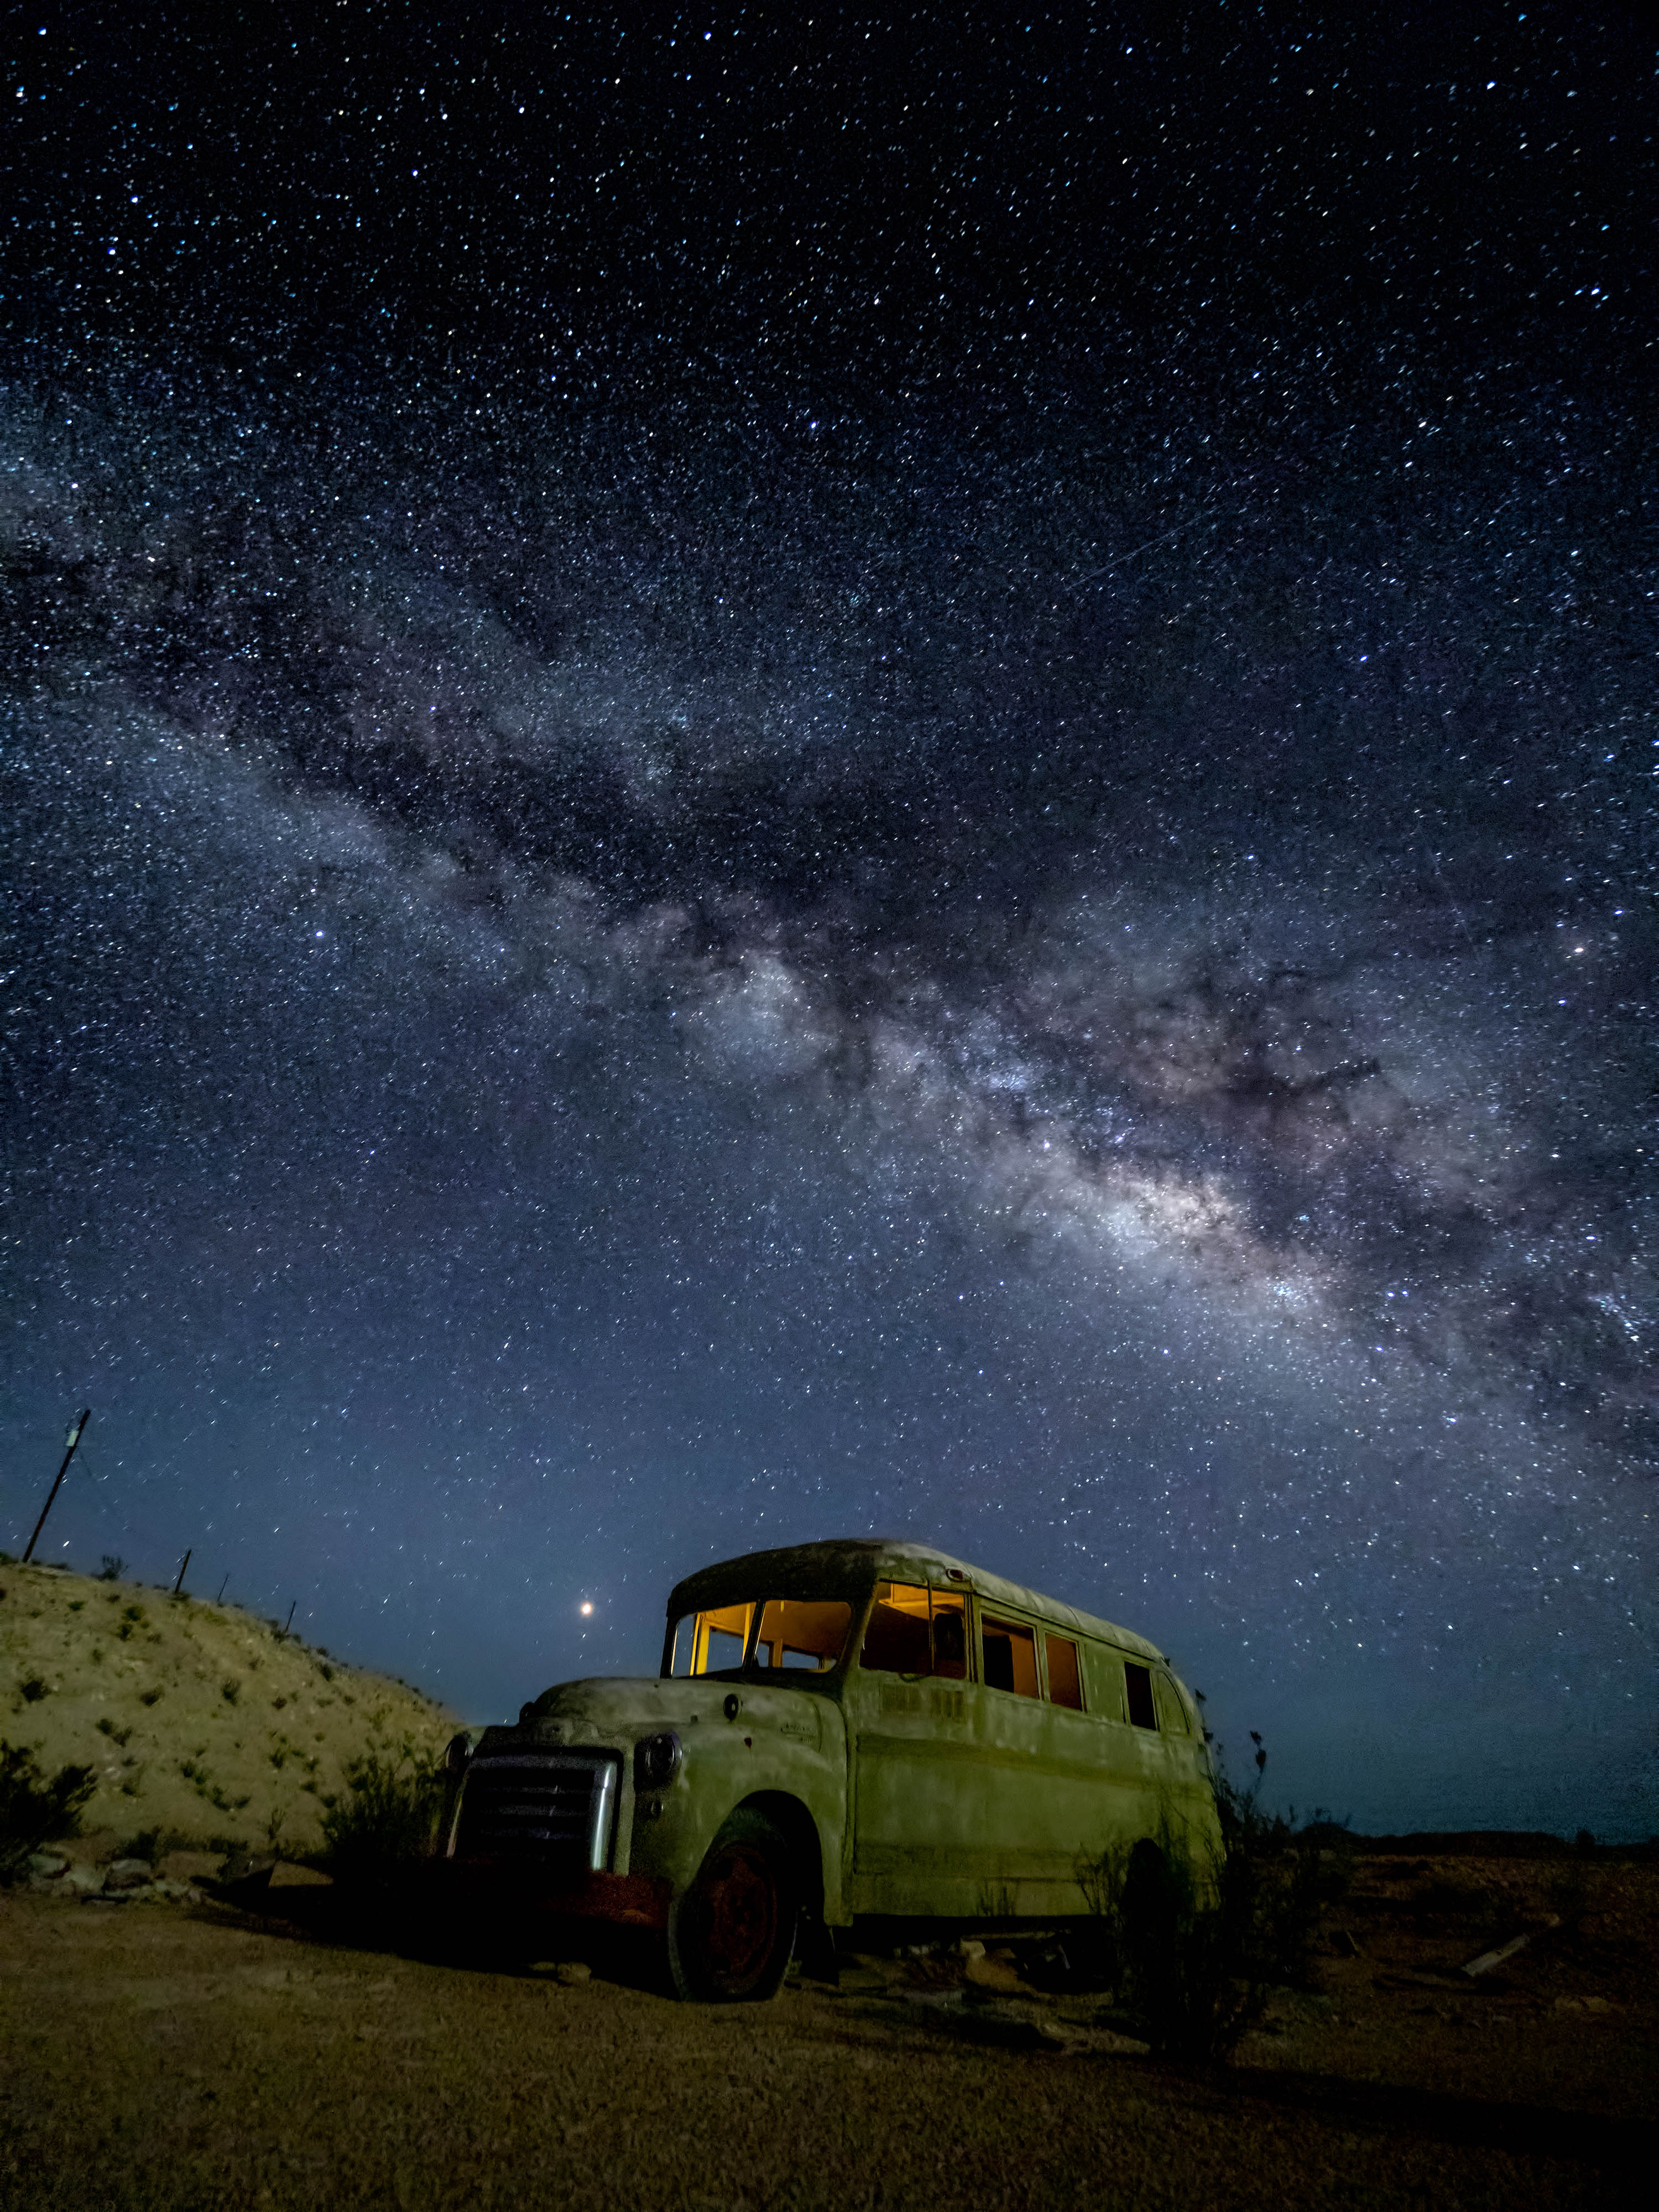
Lighting
Crescent Moonlight
Light Painting
Notes:
You may want to shoot the night sky with just a silhouette against it. That’s perfectly fine. But if you want detail in your foreground, you will need some kind of light. As I mentioned earlier, a crescent moon can give you pleasing light on the landscape. If that’s not available I’ve found that low level LED panels are great for lighting the foreground. They have a variable brightness, and at the lowest setting and with the right placement, you can leave them on during the full exposure.
In this slide, I have two images of the same bus, taken at different times on the same night. The first one was taken just before moonset when there was a crescent moon. You can see that the landscape is lit – particularly the hillside to the left of the frame.
An hour later, the moon had set, and we needed to use light painting to illuminate the bus. We used LED panels outside the bus to light the side.
In both shots we used Lume Cubes for just a second or two inside the bus.

Slide 25
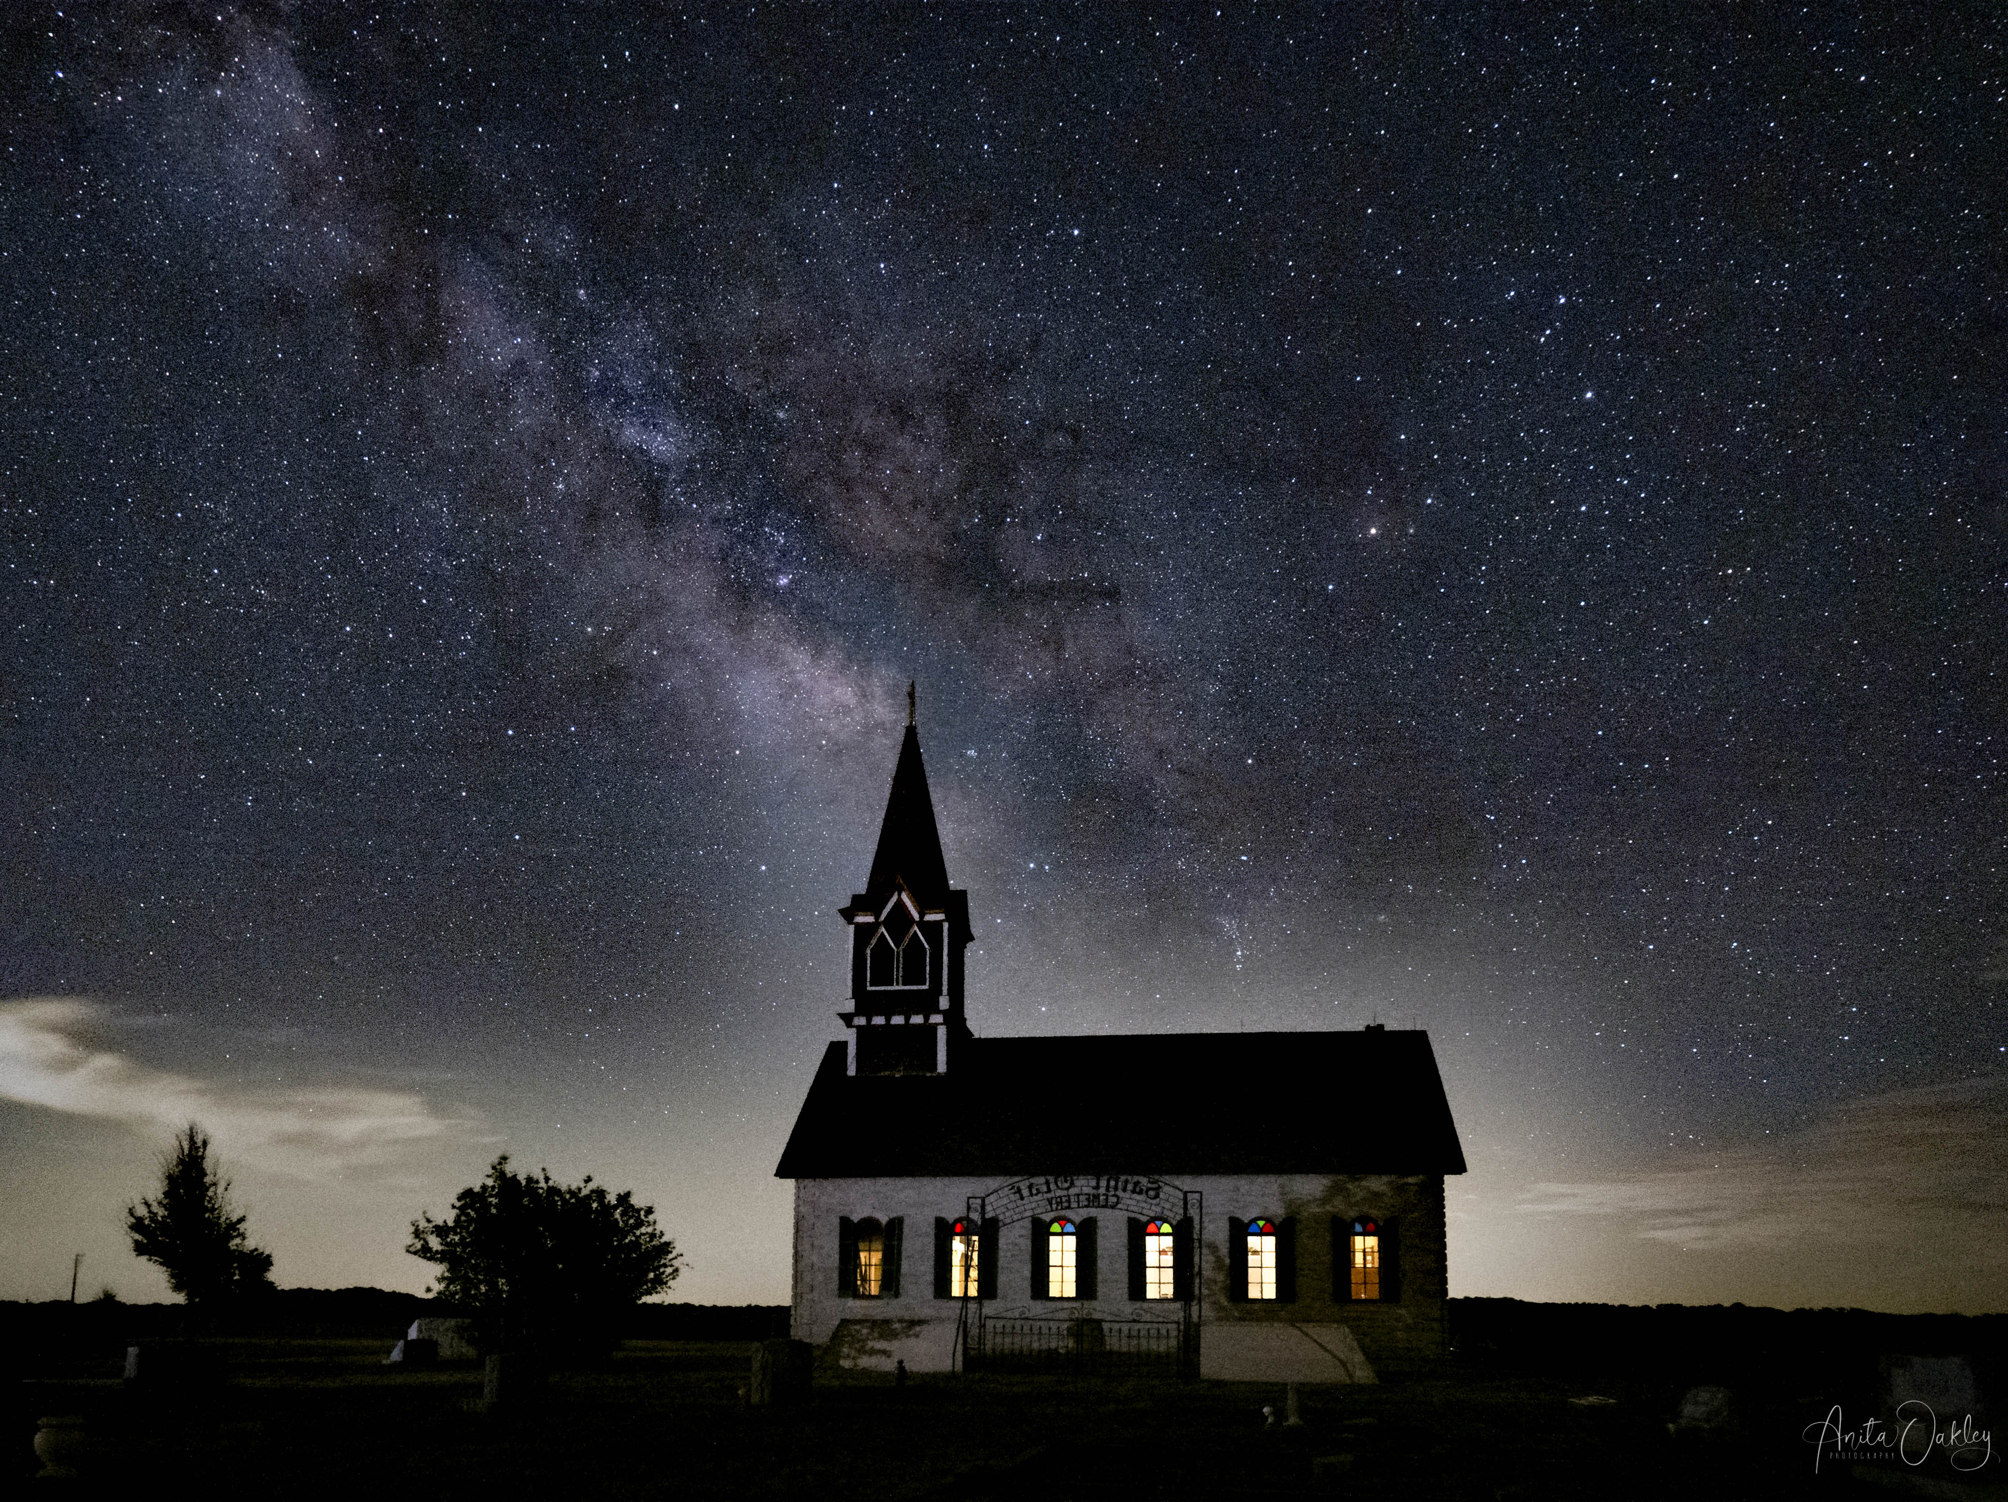
On Site: Lighting
Notes:
A word of caution – when you are using LED panels you can’t see shadows on your subject. You can hardly even see the light on the subject. I totally ruined this image of the Rock Church by placing the light where the bush on the left threw a shadow on the right side of the church. Be very cognizant of little details like that.

Slide 26
On Site - Safety
Take a friend or at least let someone know where you are going and when you will be back
Be aware of your surroundings – especially if alone
Be on the lookout for snakes, scorpions and the like
Exhaustion – Don’t drive if it’s not safe.
  Nearby hotel?
  Sleeping bag?
  Sleep in the car?
Notes:
Safety is paramount:
Take a friend or at least let someone know where you are going and when you will be back.
About shooting with friends – It’s a fine line between having an acceptable number of people and too many. Invariably someone will turn on a light while someone else is shooting. Be courteous and ask before turning on a light. Be kind if someone makes a mistake and ruins your shot. You can always take another one.
Be aware of your surroundings, especially if you are alone. Aside from people who might harm you, you could step in a hole and twist an ankle or fall and break an arm or a hip.
Depending on your location, be on the lookout for snakes, scorpions and predators.
Exhaustion – Don’t drive home if you are too tired. The first time I shot Ft Griffin, we finished about 2:00 AM, and it’s a three-and-a-half-hour drive home. I should have stopped at a hotel and checked in. I tried pulling off the road and sleeping a while, but I was too tired and wired to sleep. I pressed onward because I had to be at church the next morning to run AV. I wasn’t the smartest cookie in the box. The next time I stayed in Graham, which was an hour closer to home.

Slide 27
Questions

Slide 28
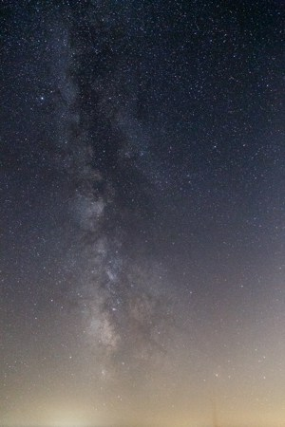
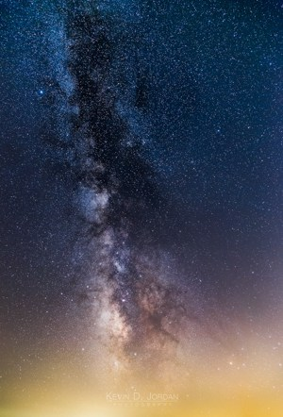
Post Processing
The Milky way before and after processing an image.
Credit Jack Nichols
Notes:
Just like you might be underwhelmed when you first see the Milky Way in person, you might be disappointed when you first download your images. They might be orange. They might look very dark. They most surely will look dim. Don’t be discouraged! They just need a little tender loving care.

Slide 29
Post Processing Continued
Balance the color first, even if you are going to make it cooler or warmer later.
  Open the file in Lightroom's Develop module.
  Crank the Vibrance and Saturation sliders up to 100.
  Move the white balance slider until you have a roughly even amount of blue and yellow.
  Reset Vibrance and Saturation back to 0.
Notes:
Ok, so it’s time to transform that dull milky star-filled sky into one of those pictures you have seen in magazines and on Instagram.
Balance the color first, even if you are going to make it cooler or warmer later. That lets you bring out the color in the stars more easily.
Open the file in Lightroom's Develop module.
Crank the Vibrance and Saturation sliders up to 100. This will make the image look hideous, but it's only temporary.
You'll notice that the image is a collection of blue and yellow splotches. Your goal is to move the white balance slider until you have a roughly even amount of blue and yellow. You can also use the brush and gradient tools to smooth out hotspots.
When you think you have roughly as much blue as you have yellow, reset Vibrance and Saturation back to 0. Presto, your image is neutral.

Slide 30
More Post Processing
Adjust exposure, etc.
Clarity and dehaze are your friends.
If shot separately, treat the foreground and background separately. Masks in Photoshop.
Adjust temp to taste. Warm or cool?
If you stacked shots – copy all changes to the rest if the images, and then stack for noise.
Dodge and Burn in Photoshop
Good video: https://www.jacknicholsphoto.com/processing-a-single-shot-milky-way-photo
Notes:
Adjust exposure, etc.
Clarity and dehaze are your friends. Use some to start with and then add a radial gradient over the Milky Way and add a bit more.
If shot separately, treat the foreground and background separately. Blend using masks in Photoshop.
Adjust color temperature to taste. Warm or cool? It’s up to you. I prefer mine a little on the blue side.
If you stacked shots – copy all changes to the rest if the images, and then stack for noise. Starry Landscape Stacker for Mac, or Sequator for Windows. We will try to do a demo of Sequator at a later date.
Dodge and Burn in Photoshop to enhance the Milky Way a little, but don’t get too heavy handed.
You might like this video: https://www.jacknicholsphoto.com/processing-a-single-shot-milky-way-photo

Slide 31
Post Processing Continued
Demo
Notes:
Basic edit
If time, stack

Slide 32
Final Questions?

