Slide 1
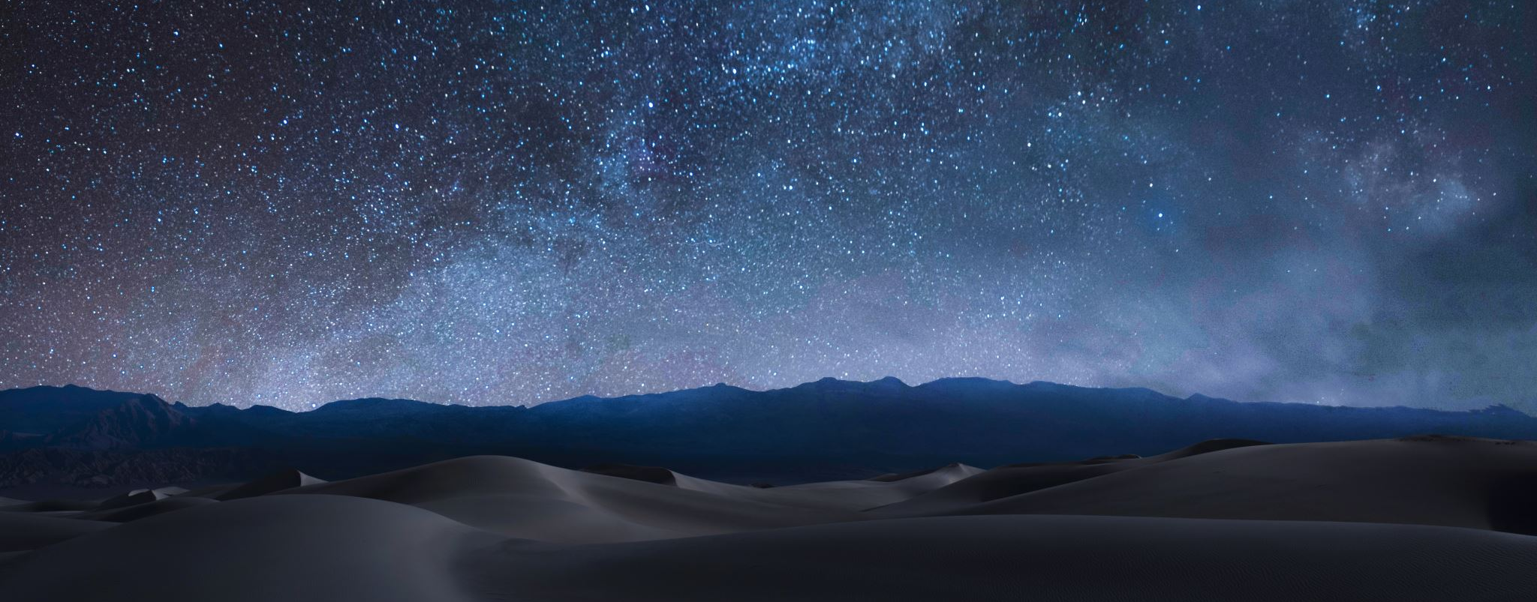
Time-Lapse Photography
Shooting and Processing
Notes:
Time lapse photography is challenging. I started trying to do time lapses last year on my storm chases and was able to get a few short sequences. But there’s a lot to creating a compelling time lapse, whether it’s of the sunset, the Milky Way, or a storm season, and to be perfectly honest I’m not there yet. After this year’s monsoon I feel much more comfortable about getting good sequences. Next I need to improve my ability to string them together. But more about that later.
First, we talk about capturing a sequence

Slide 2
The Easy Way
Your iPhone (maybe Android)
Secure it on a tripod and shoot – the phone does the work
Not as good a result, but it’s easy
Notes:
Modern phones have amazing capabilities. You have been able to take a plain video for ages. But now you can do slow motion and time-lapse.
You just need to secure your phone so that it’s steady, set it to time-lapse, and let it go.
Of course, the results aren’t professional, but it’s easy.

Slide 3
High Quality Time-Lapse is a Two Part Process
Taking a sequence of images
Creating a time-lapse
Lightroom
Filmora
Panolapse
LRTimelapse
Notes:
High-quality time-lapse videos are quite a different matter.
You need a good quality camera with built-in intervalometer, or a separate intervalometer that you can attach to the camera.
You take a sequence of images, and string them together in post processing. There are many different programs
My software of choice is LRTimelapse. It’s a bit expensive, but it works great and integrates with Lightroom.

Slide 4
Setting up for Time-Lapse
Set everything manual
Figure out how long you want the time-lapse sequence to be
What your frames per second will be
Typically 300 or 240 FPS
How long you need for intervals - it’s all relative
Notes:
To take time-lapse sequences
Set everything manual
Important for white balance and exposure to be consistent. It’s even more important than when you are doing Milky Way shots. You will see why when I show you LRTimelapse
You might have to adjust ISO partway through if it’s getting dark, if your camera allows that. Mine doesn’t.
Figure out how long you want the time-lapse sequence to be. Though when we are storm chasing, I frequently just set mine to 9999 frames and let it go until we have to move.
Decide what your frames per second will be, though that can be changed in post
Typically 300 or 240 FPS. I prefer 300 for its smooth appearance. Others prefer 240 for a more cinematic effect.
How long you need for intervals - it’s all relative For instance:
For storms or clouds over the landscape – 1 second intervals
For the Milky Way you can use 15-30 second intervals.
In some cameras and intervalometers, you must add in the shutter speed. That is, most intervalometers count the interval from the time you trip the shutter. For instance, if you have a 5 second exposure, and you want a 1 second interval, you need to set the interval for 6 seconds. My camera starts counting the interval from the time the shutter closes. Test yours out ahead of time.

Slide 5
Taking a Sequence is Time Consuming
For a 10 second sequence
30 frames per second
300 frames
1 second between shots
= 5 minutes just on the intervals
Notes:
Taking a Sequence is Time Consuming. Do the math:
If you want a 10 second sequence with 30 frames per second
You have to shoot 300 frames
With 1 second between shots
It takes 5 minutes just for the intervals
If you want to string them together to make a 10 minute video, you need 5 segments a minute, 50 segments total, 250 total minutes filming, or 4.25 hours
Then if you were shooting 10 second frames with 1 second intervals, the shots themselves take 50 minutes, with another 5 for the intervals. You kind of have to want it bad…
And not all the segments are good enough to use so overshoot! Take many more sequence than you need!

Slide 6
Or You Could Time-Lapse the Milky Way
20 second exposures
15 second interval
35 seconds per shot
Let it run for hours…
Lots of battery power
Notes:
Sometimes you want to timelapse a long process like the Milky Way, or a building demolition.
15 second interval
Let it run for hours…
You consume lots of battery power, but the advantage is that your exposure can stay constant throughout.

Slide 7
Getting the Interval Right
Figure out how fast your subject is moving.
Growing plants? Take a picture once a day.
Sunset? Maybe 2-3 seconds
Lightning? 1 second with a longer shutter speed
Notes:
So, to get your interval right figure out how fast your subject is moving.
Growing plants? Take a picture once a day.
Sunset? Maybe 2-3 seconds
Lightning? 1 second with a longer shutter speed

Slide 8
Processing the Clip
NVideo
Filmora
Photoshop
iMovie (Mac only)
Shotcut
LRTimelapse
Notes:
So now you have 350 frames in sequence. What do you do next? You have to put them together in post. Here are some programs you can use to process a time lapse sequence
NVideo
Filmora
Photoshop
iMovie (Mac only)
Shotcut
LRTimelapse

Slide 9
LRTimelapse (My Tool of Choice)
LRTimelapse for Mac or Windows
Works with Lightroom
Communicates with Lightroom through sidecar files and metadata
Lightroom exports the developed images
LRTimelapse creates the movie
Notes:
LRTimelapse is my tool of choice. It’s available for Mac or Windows. Why do I love it so much?
The program works with Lightroom - LRTimelapse communicates with Lightroom through sidecar files and metadata
LR timelapse saves metadata to files, and Lightroom reads it
Lightroom saves metadata to files, and LRTimelapse reads it
They are symbiotic.
Finally, Lightroom exports the developed images and makes a remote call to LRTimelapse, which creates the movie clip. You can also create the final clip through LRTimelapse, but they suggest using Lightroom to export the files because you get better quality.
LRTimelapse can blend developing changes over many frames. Say you do sunset. LRTimelapse will blend the exposure and colors for a seamless transition.
It’ll smooth out flicker. I’ll show you what that means in a little while.

Slide 10
So Let’s Create a Time-Lapse

Slide 11
What Now?
Multiple short clips can be assembled into a longer movie
Adobe Premier Rush
Clideo’s Online Video Creator
Upload clips and do everything through a web interface
Movie Maker for Windows
Moravi Video Editor
After Effects
Premier Pro – Adobe
Notes:
Making a 10-20 second time-lapse is fun and I found it thrilling the first couple of times I did it. But what do you do with a 20 second time lapse except amaze your friends?
You string together all your related short clips into a longer movie, typically 5-15 minutes, set music to it, and post it on YouTube, of course.
Just like creating the clip, there are several different programs that you can use to create the movie. Some are listed on the screen. Some of them are web based, some are programs you install on your hard drive. Some are very full-featured; others are rudimentary.

Slide 12
How?
Pick music - First
Decide what order to present clips
Time clips to work with music
Great Example
Short Storm Timelapse
Notes:
It’s a matter of matching the music to the clips and managing your transitions so everything works together.
So how do you do that?
Pick the music first – Why? Because it will set the tone for your transitions. Knowing what the music will do enables you to sequence your clips.
Once you have them inserted, you can switch them around and cut them as needed to create your transitions.
Notice in this short sample how the scenes get more dynamic as the music builds. Notice how every time there is a single piano note, the scenes transition.
Play https://www.youtube.com/watch?v=UNtL6KCG51k
Now that our export is done, let’s build a movie clip.

