Slide 1
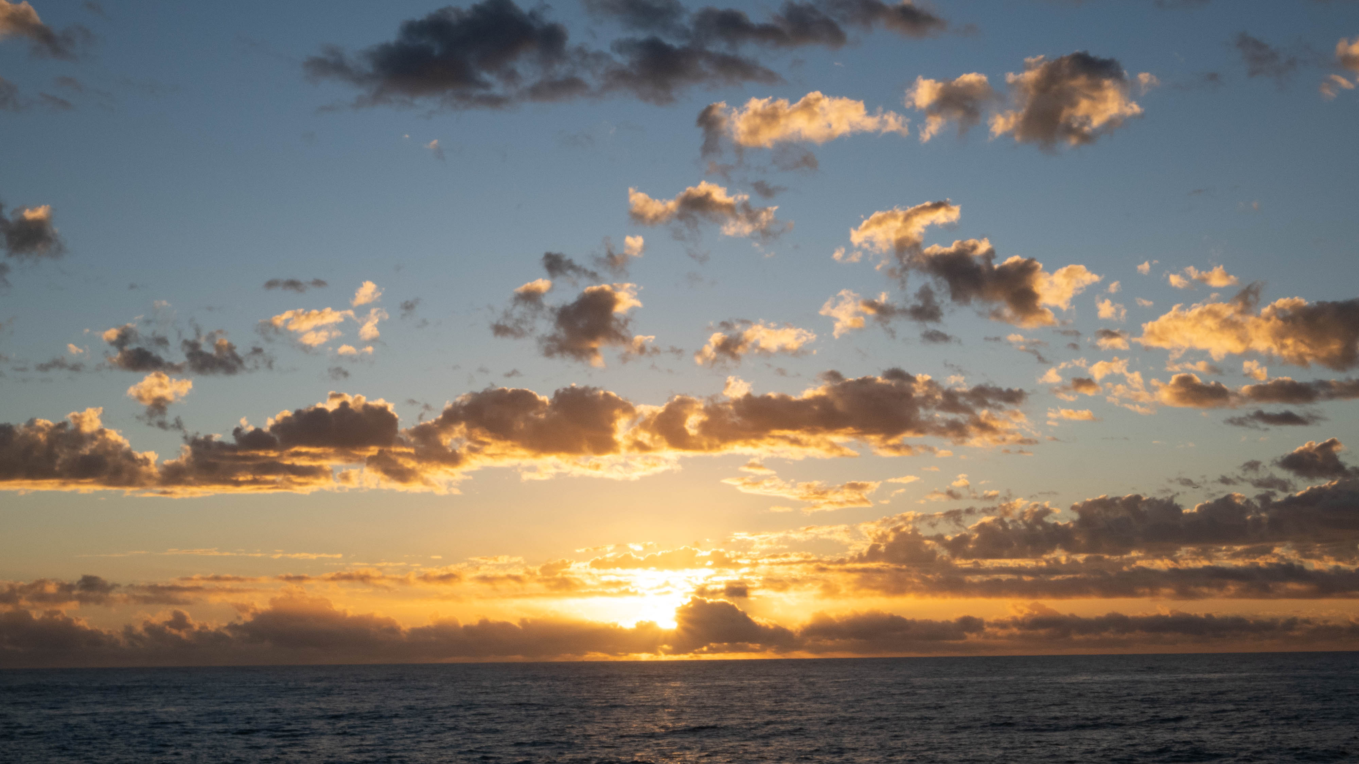
Creating a Time Lapse

Slide 2
Agenda
Why?
Shooting a Sequence
Creating a Clip
Picking Music
Putting it all together
Exporting
Notes:
Tonight, we will cover just shooting a sequence and creating a clip. Those will involve your camera and a software package to create the clip from individual shots. I use LRTimelapse. I have the Pro version (285 Euro), but you can create 1080 clips with the free version so I would advise starting with that.
Next week we will cover picking music to accompany the time lapse, creating a timeline, and exporting the finished movie.

Slide 3
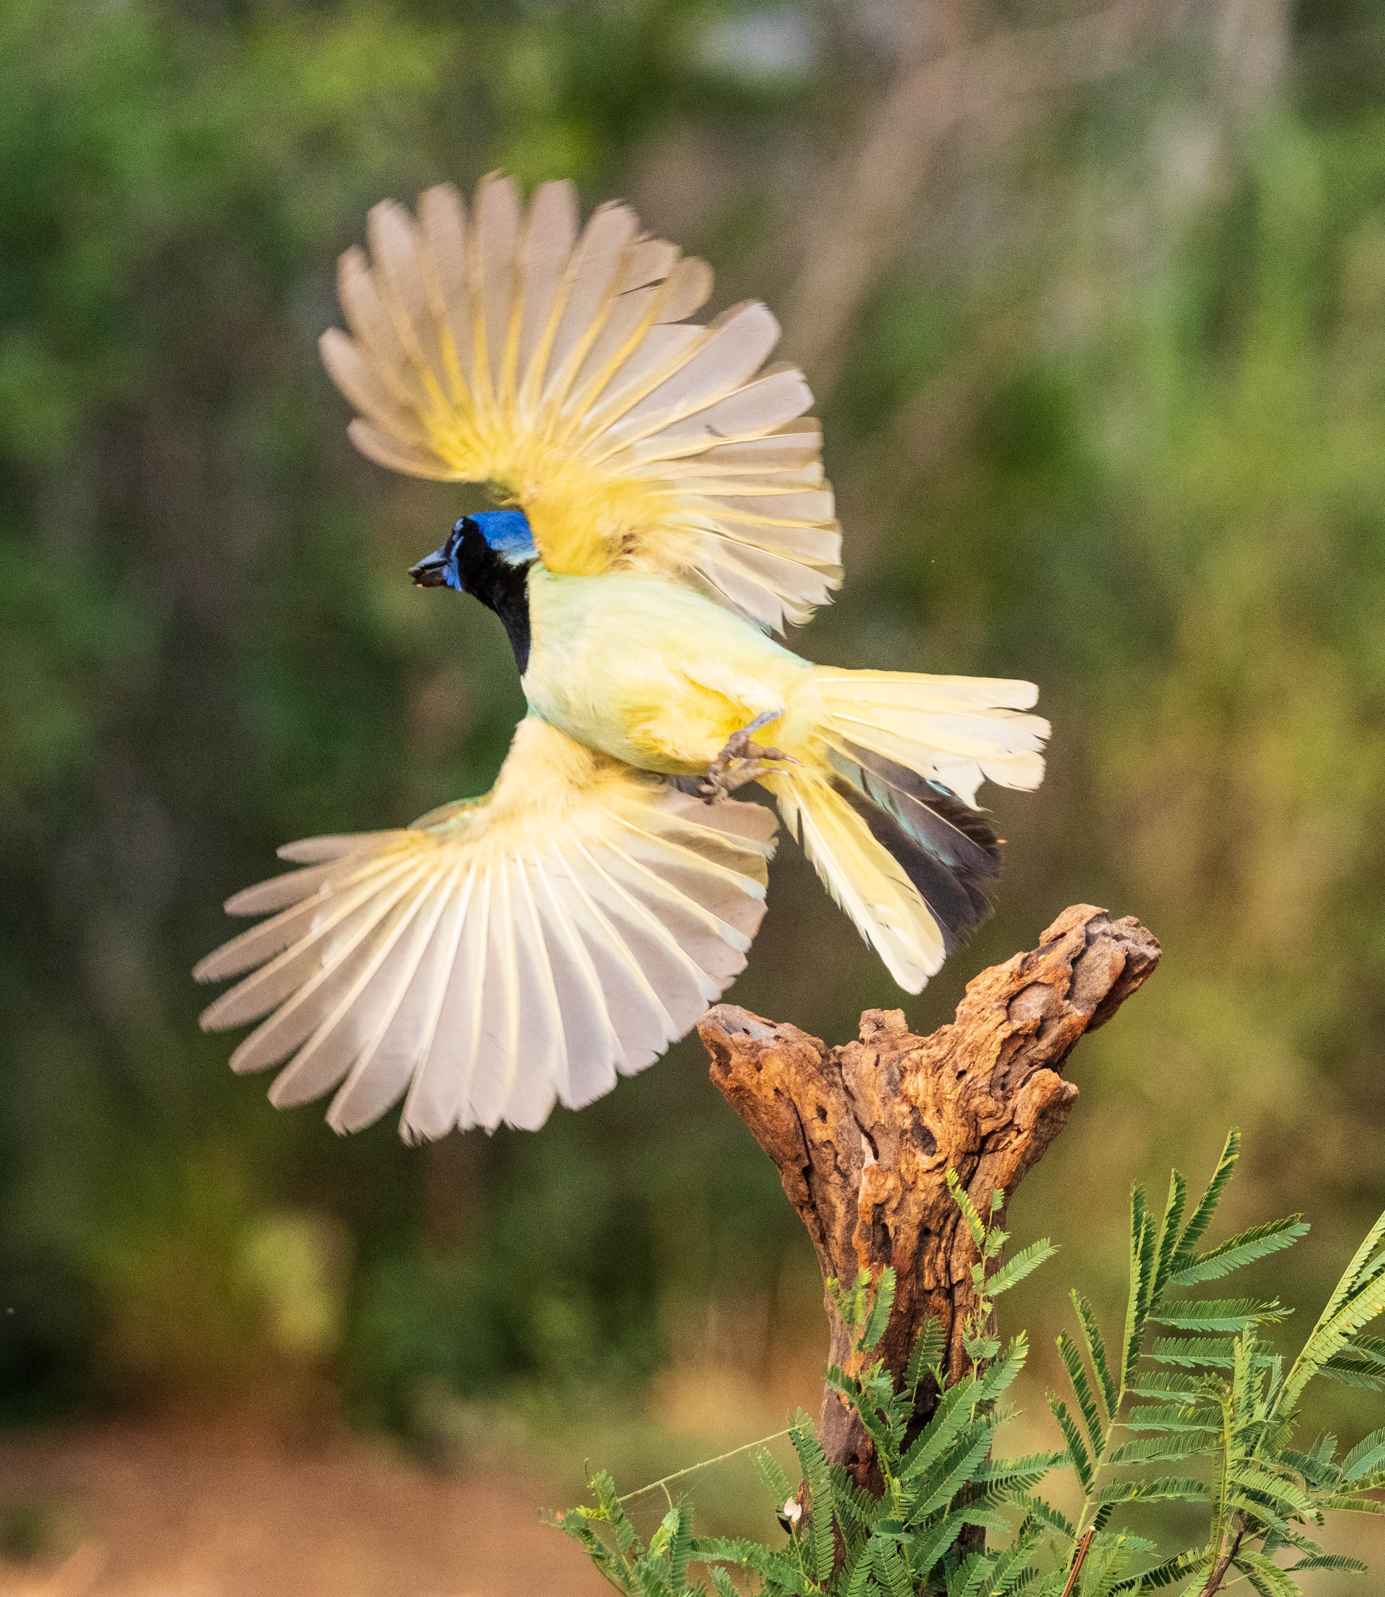
Why Time Lapse?
Time-lapse communicates effectively because it captures the essence of time itself.
Notes:
Time lapse has the advantage of coming in as still images, so you can pull out a single shot and process it as well as use it in the movie. You have all the advantages of shooting in RAW. You have wide creative possibilities.
We all know that a single still shot can tell a story. It can even provide a sense of motion through creative blurring of portions of the scene.
But time lapse can capture time itself and condense it to reveal a world of change or complex processes in a way that still photography simply cannot touch. You can show a plant growing, a flower blooming, a building’s construction, a sunrise, sunset, or the stars moving in the sky. In my case, I started doing time lapse to capture the excitement of storm chasing.
Time lapses reveal what the eye cannot perceive. They can evoke a sense of wonder and awe. They communicate in an entirely new way.
You must have a good tripod, an intervalometer or camera with interval shooting built-in.
6 stop filter to slow the shutter speed is very helpful.

Slide 4
Where to Start?
It all begins with a series of still photographs taken at regular intervals. It can be a slow process
Important steps:
Make sure your sensor is spotless
Determine what intervals to shoot – it depends on the speed of change
Manual everything – focus, exposure, ISO. You can ramp ISO up a bit if you are shooting a sunset, but you want each shot consistent with those on either side.
Notes:
Time lapse takes a long time. If you want a 10 second clip, shooting at 30 frames a second, it takes 5 minutes.
To make a 10-second time-lapse at 30 frames per second (fps), you need:
10 seconds × 30 fps = 300 frames (photos), so you need to shoot 300 individual frames.
How long this takes depends on your shooting interval:
Time1 second = 5 minutes
2 seconds = 10 minutes
5 seconds = 25 minutes
10 seconds = 50 minutes
30 seconds = 2 hours and 30 minutes
1 minute = 5 hours
Your interval can be anything between a second (or half on come cameras) to days or weeks. It depends on how fast your subject changes. For storms I usually shoot at 1 second intervals. But for the Milky Way, perhaps every 15 to 30 seconds. If I were going to shoot a plant growing, a good interval might be once a day. You pretty much have to guess. If you don’t know, pick a little more often than you think you will need. You can always throw out every other shot.
Shoot more than you think you will need. You may need to trim to fit the music you picked, which is fine. But it’s impossible to stretch a clip out.
Clean sensor:
When you are shooting stills, you can spot the image perfectly well and it doesn’t take very long. If you are creating a time lapse, you can’t just fix the spots and copy/paste that into the other shots. Any spots will float in the middle of the frame as the movie progresses. If you know you have any spots, shoot the widest aperture you can to minimize any spots. Enter the ND filters.
Manual shooting: Why manual everything? You want your time lapse to show changes in luminance, rather than have your camera compensate if the sun comes out or goes behind a cloud. If there are wide swings in light, and you are shooting aperture priority, your shutter speed will change. For a smooth time lapse you want a slower shutter speed (max of twice your FPS). If you shoot Shutter priority, your Depth of Field won’t be consistent.
Where it comes to focus, you can’t count on your camera’s focus to be spot-on throughout a 300 shot series, and you don’t want your time lapse to go in and out of focus. Trust me – I learned these things the hard way.
The hardest thing: Leave your camera alone to do its thing! Don’t get distracted by shiny opjects!

Slide 5
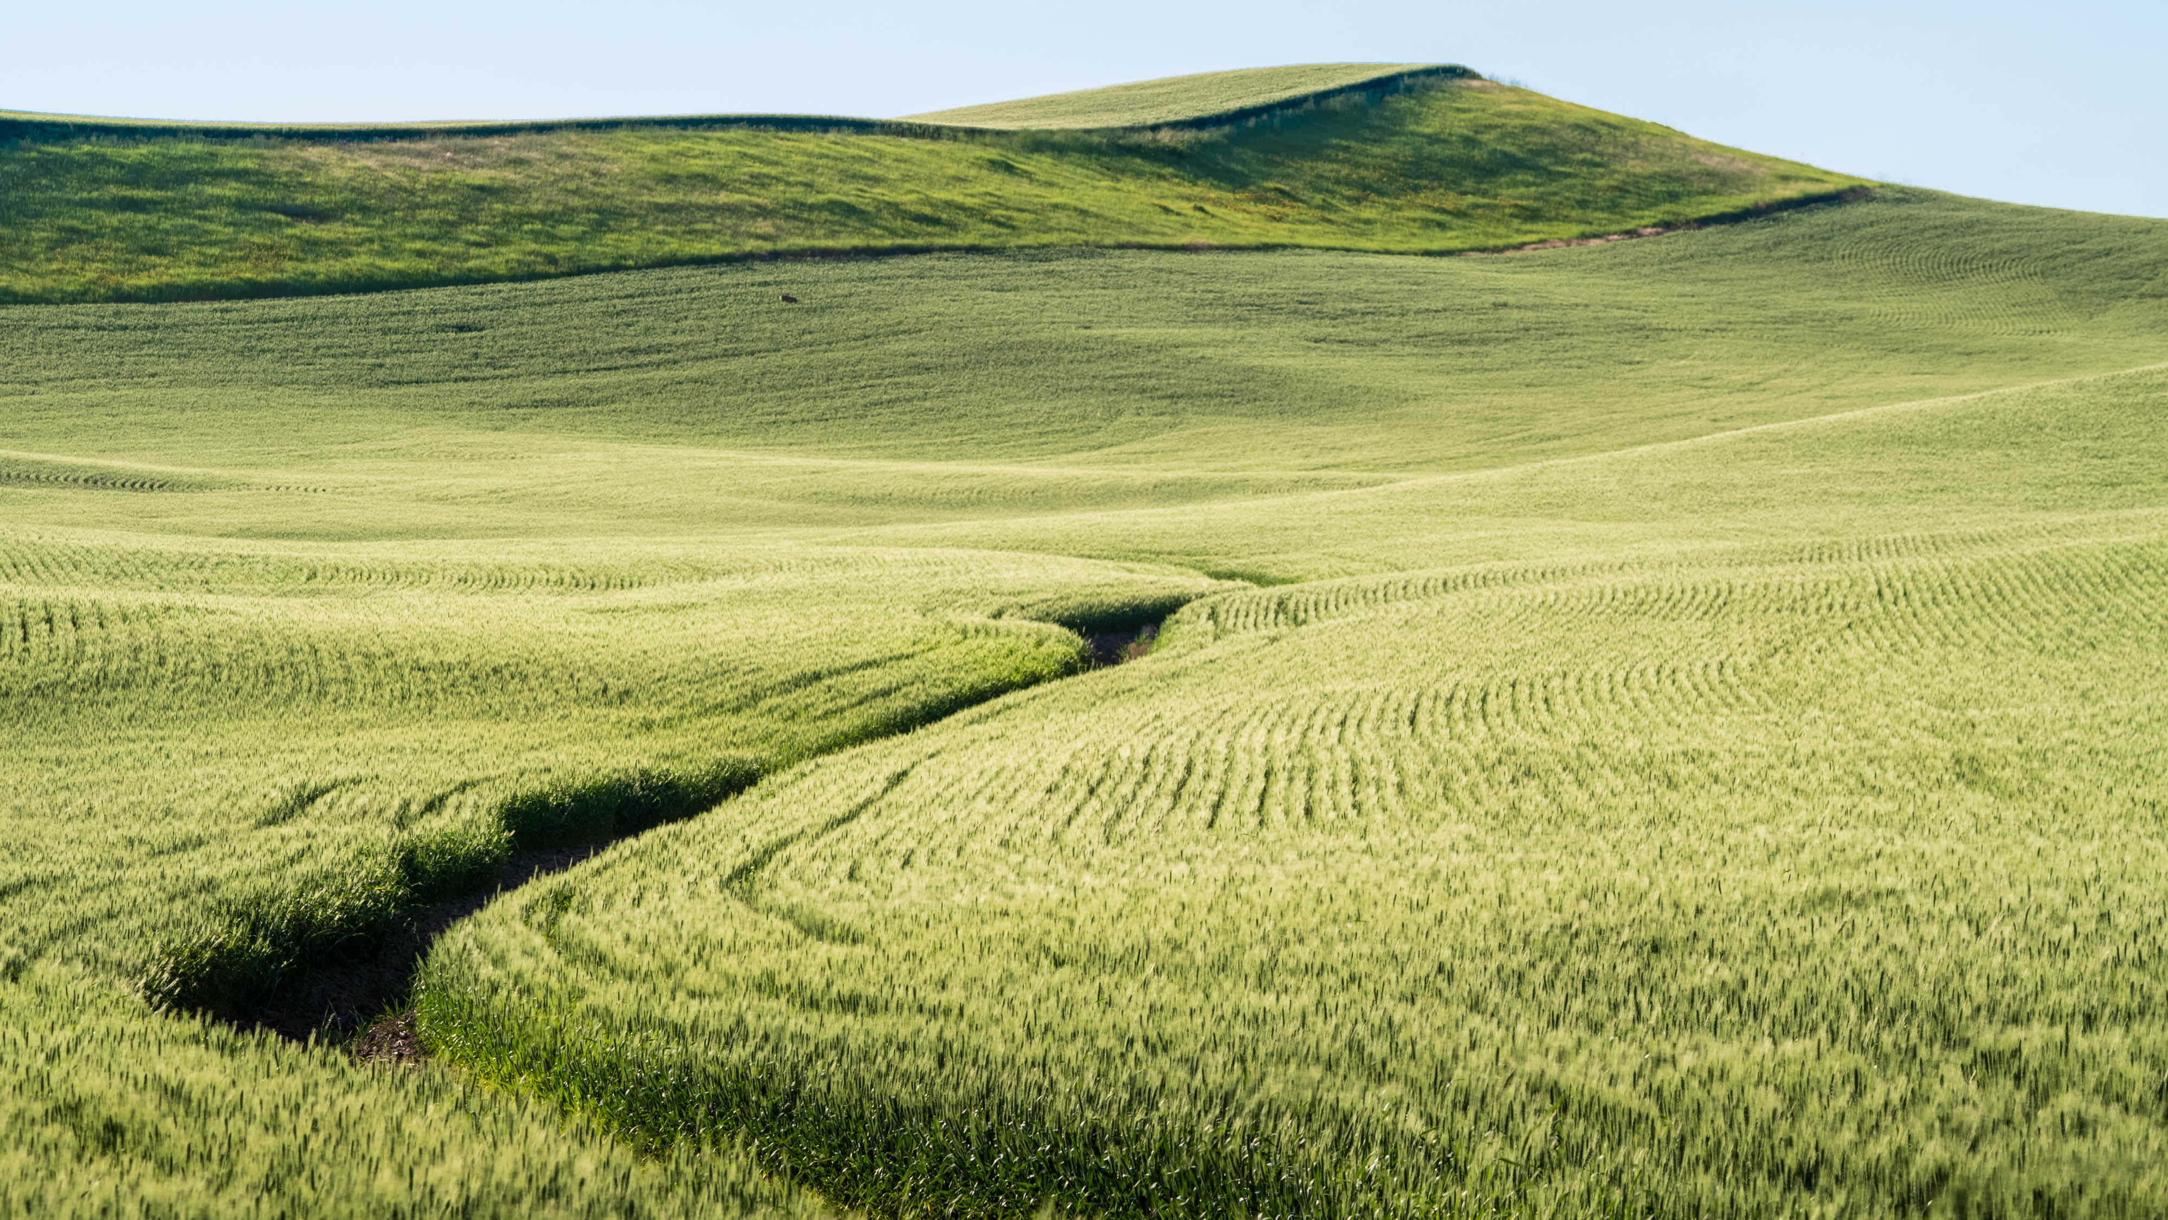
So What Now?
Creating a clip
Notes:
You have a 400 image sequence, captured perfectly… Now What?
There are several software packages you can use to create a time lapse:
Adobe Premiere Pro
Import image sequences as video
Full control over transitions, music, effects
DaVinci Resolve (Free & Studio versions)
Import image sequence via Media Pool > Image Sequence
Professional-grade color grading and export options
Final Cut Pro (Mac only)
Drag and drop stills, set duration, adjust speed easily
iMovie (Mac/iOS) – Basic option
Suitable for casual use, limited control
Vegas Pro (Windows)
Import image sequences directly into timeline
Good for quick assembly and export
But I use LRTimelapse – The main advantage is that it integrates with Lightroom for editing a few of the individual shots, and automatically smoothes the transition between them. That is, you use keyframes and only have to edit those. LRTimelapse writes the metadata to all the interim images, exports all of the frames and builds a movie file.
Let’s go take a look at the process!

Slide 6
Part 2 – Putting it All Together!
So – you have a bunch of 10 or 20 second time lapse clips – what is that going to do for you? BORING!

Slide 7
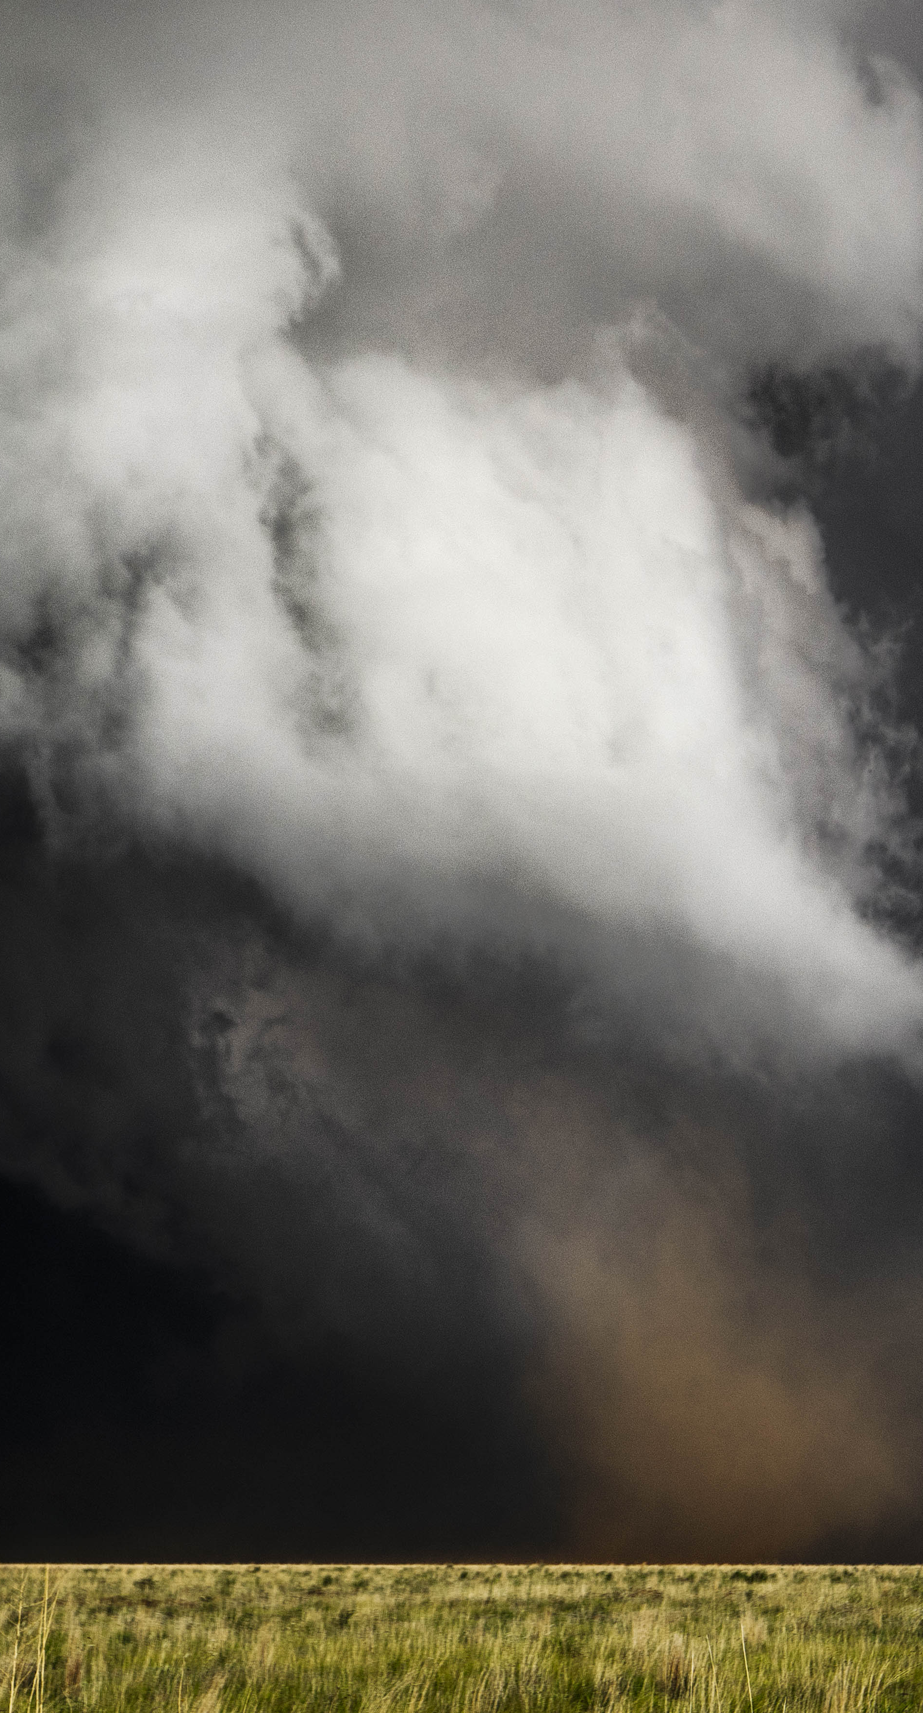
Impact
If you want to make an impression on anyone, you need a finished product. Music, multiple clips put together, transitions, video clips mixed with time lapses? Maybe even include sound effects. Hmmm. Where do you even start?
Notes:
Start with the right software package. I love DaVinci resolve by BlackMagic Design.
It’s free! Yes, you can pay about $300 for the pro package, but you can do 90% as much with the free version. If you aren’t making full feature-length movies there is little reason to go that way.
Includes drag and drop editing, automatic trim tools, and powerful new AI text based editing plus hundreds of titles, transitions, and effects.
Do you want to include video clips? DaVinci does color grading.
Create cinematic visual effects and motion graphics!
https://www.blackmagicdesign.com/event/davinciresolvedownload

Slide 8
DaVinci Resolve
From Blackmagic Design – www.blackmagicdesign.com
  No need to buy the pro version – the free one has almost all the features.
Combines editing, color correction, visual effects, motion graphics, and audio all in one software tool!
Once you get the hang of it it’s intuitive, but there is a learning curve! This is professional-quality software.

Slide 9
Start With the Music
It’s almost impossible to get all your clips into order and add music later. You want your clip transitions to match the music. More about that later.
Be careful when picking music – don’t run afoul of the copyright laws. Download royalty free music. There are several sources. Fo personal use, you probably won’t spend more than $5 for a download, though most sites are subscriptions so figure in the subscription price. For commercial use, prices can go up to $2000 or more.
Artlist.io
Audiojungle
Musicbed

Slide 10
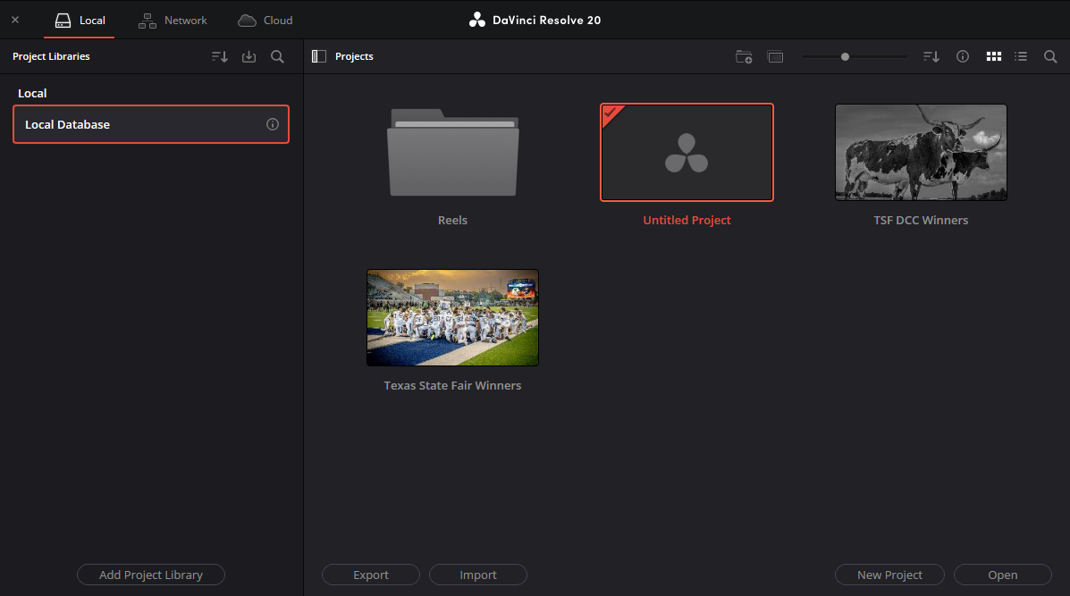
Start Screen

Slide 11
Create a Project
Name your project
  Project Settings
  Timeline Resolution - 1920x1080
  Frame rate - 23.976
  Video Format – HD 1080p 23.976
Notes:
Name your project
Project Settings
Timeline Resolution - 1920x1080
Frame rate - 23.976
Video Format – HD 1080p 23.976
Leave everything else alone
You can have folders – right click on the projects window and pick new folder

Slide 12
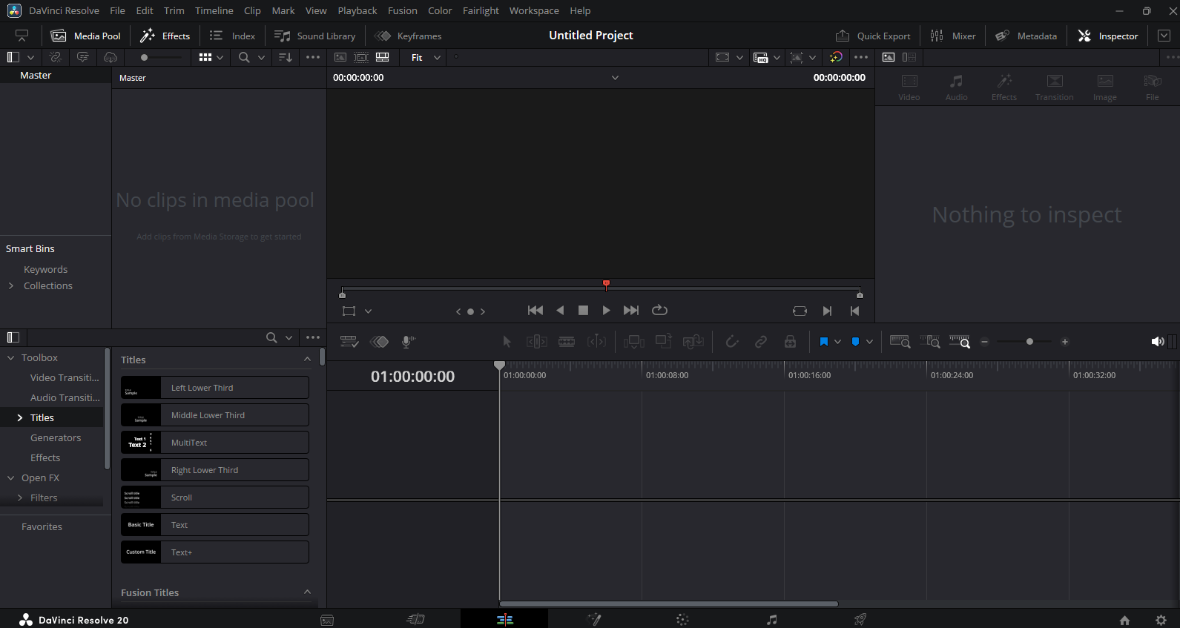
Davinci Interface

Slide 13
Lay in the Clips
You want your clips to follow the music. Build in more dramatic clips when the music builds. Calmer ones when the music is quiet and melodic.
Transitions also follow the music – if there’s a strong downbeat, plan a cut – an abrupt change from one clip to another. Other times, use a gentler transition. Cross fade, fade to black and back, etc.
Lay in any sound effects you like. Thunder during a scene with lighning? Birdsong for a forest or pastorial scene?
Notes:
Let’s do it!
You want your clips to follow the music. Build in more dramatic clips when the music builds. Calmer ones when the music is quiet and melodic.
Transitions also follow the music – if there’s a strong downbeat, plan a cut – an abrupt change from one clip to another. Other times, use a gentler transition. Cross fade, fade to black and back, etc.
Lay in any sound effects you like. Thunder during a scene with lighning? Birdsong for a forest or pastorial scene?

Slide 14
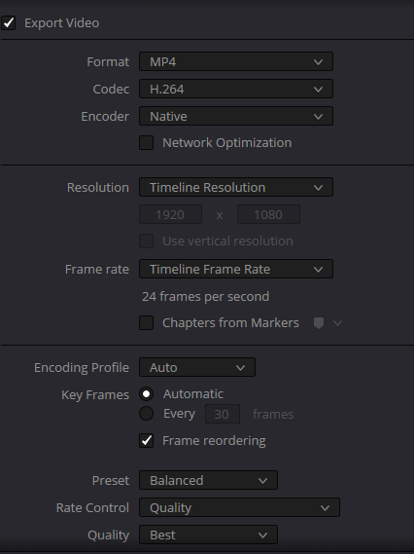
Export Your Movie
Set your options
Add to render queue
Render

Slide 15
Demo

Slide 16
Final tips & takeaways
You need more footage than you think you do.
Crossfades require an overlap in the clips
Use H.265 render settings for individual time lapse clips, H.264 for the final movie if hardware compatibility is important.
Notes:
When you are out shooting, take the time to shoot a little video. Take two cameras. Set one up for a time lapse and take stills with the other. If you do that consistently you can do a movie that shows your year’s experiences effectively.
If you want to add effects like a Ken Burns Effect – a popular effect that combines slow zooming and panning over still images or video – use a higher resolution for your clips than the overall video. That way you can zoom to 2X without pixelating.
Crossfades require an overlap. If you don’t have that, it’ll trim both of the clips a little, so allow for that in your timing. Trust me on this. The first video I made, I had all the clips in order and timed to my music. Then I tried to add crossfades – it shortened both clips and messed up my timing.
You have several choices for export render settings. H.264 will allow playing on a wider variety of hardware. Use H.264 if you need maximum compatibility (e.g., web playback, older hardware). Use H.265 if you want smaller files or better quality at lower bitrates, especially for 4K video, and your target platform supports it.

Slide 17
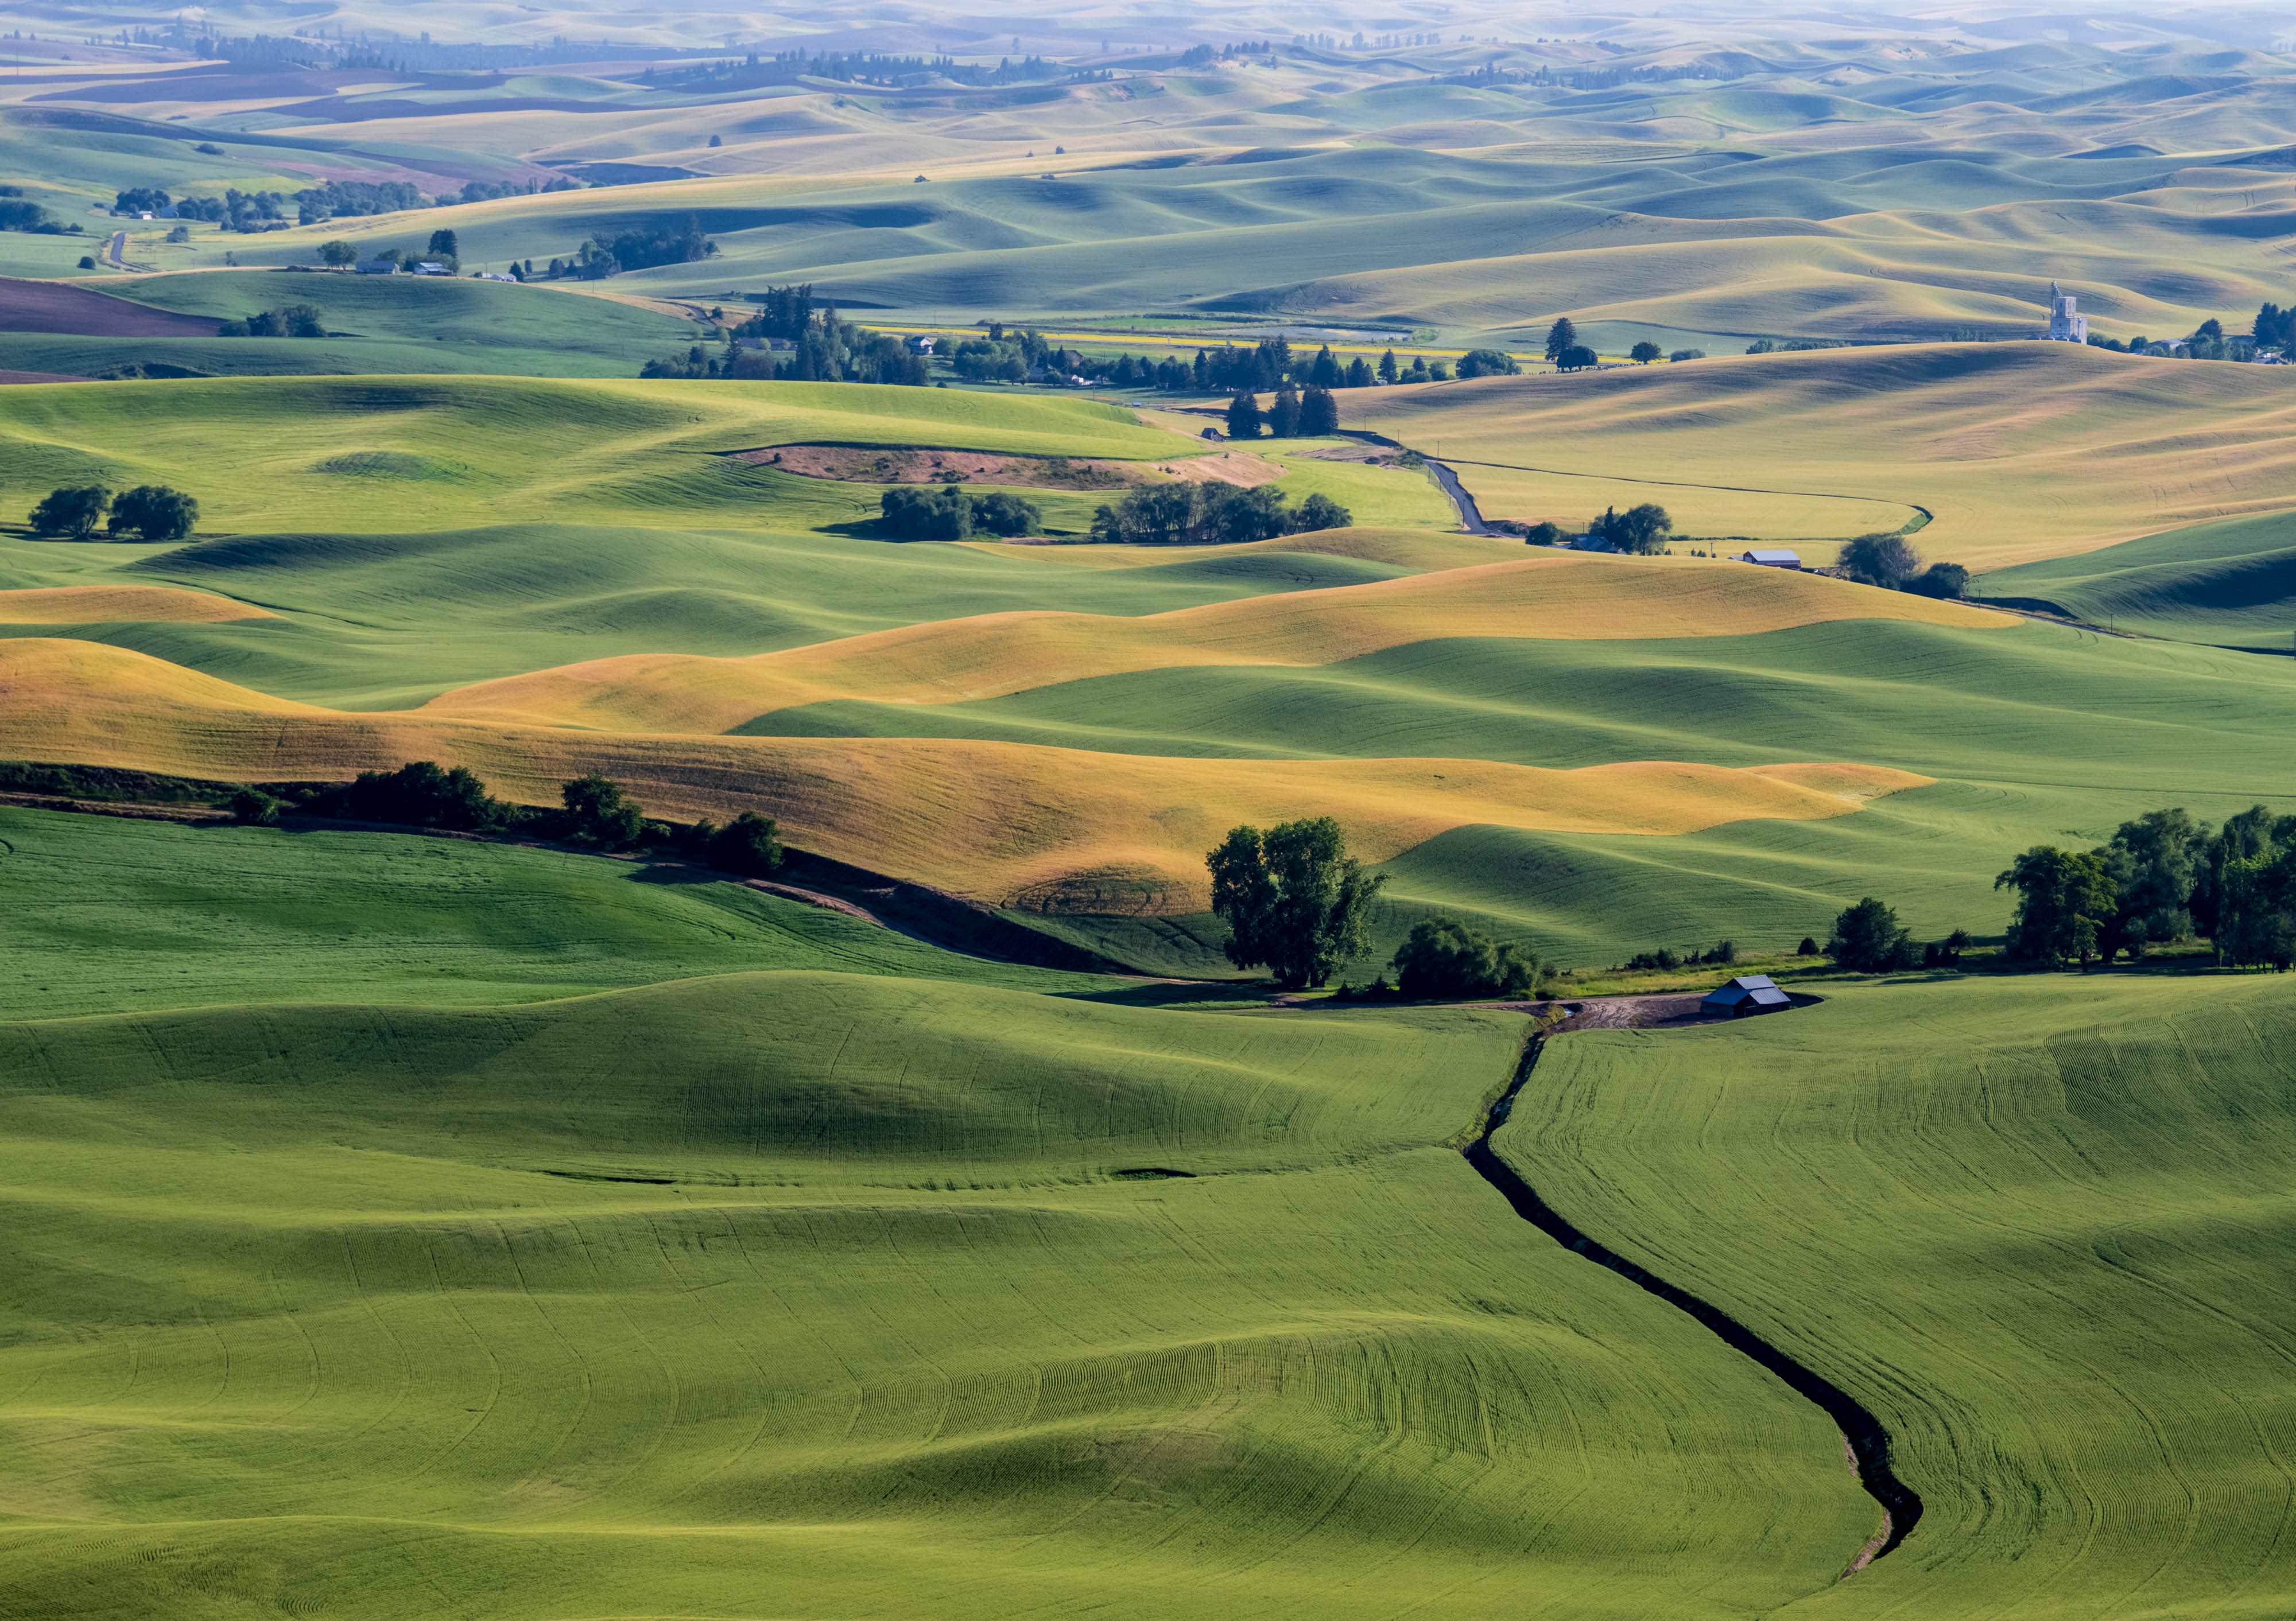
Thank you
Anita Oakley
anitaoak@outlook.com
Instagram: anitaophotos

