Slide 1
New Meeting Facility
Northaven Church
Transition
Don Haig
12/12/23

Slide 2
Agenda
Farewell to Congregation Shearith Israel
Northaven Church Facilities Overview
  Parking
  Building Access
  1st Floor Plan
  2nd Floor Plan
Moving Plan
Q & A

Slide 3
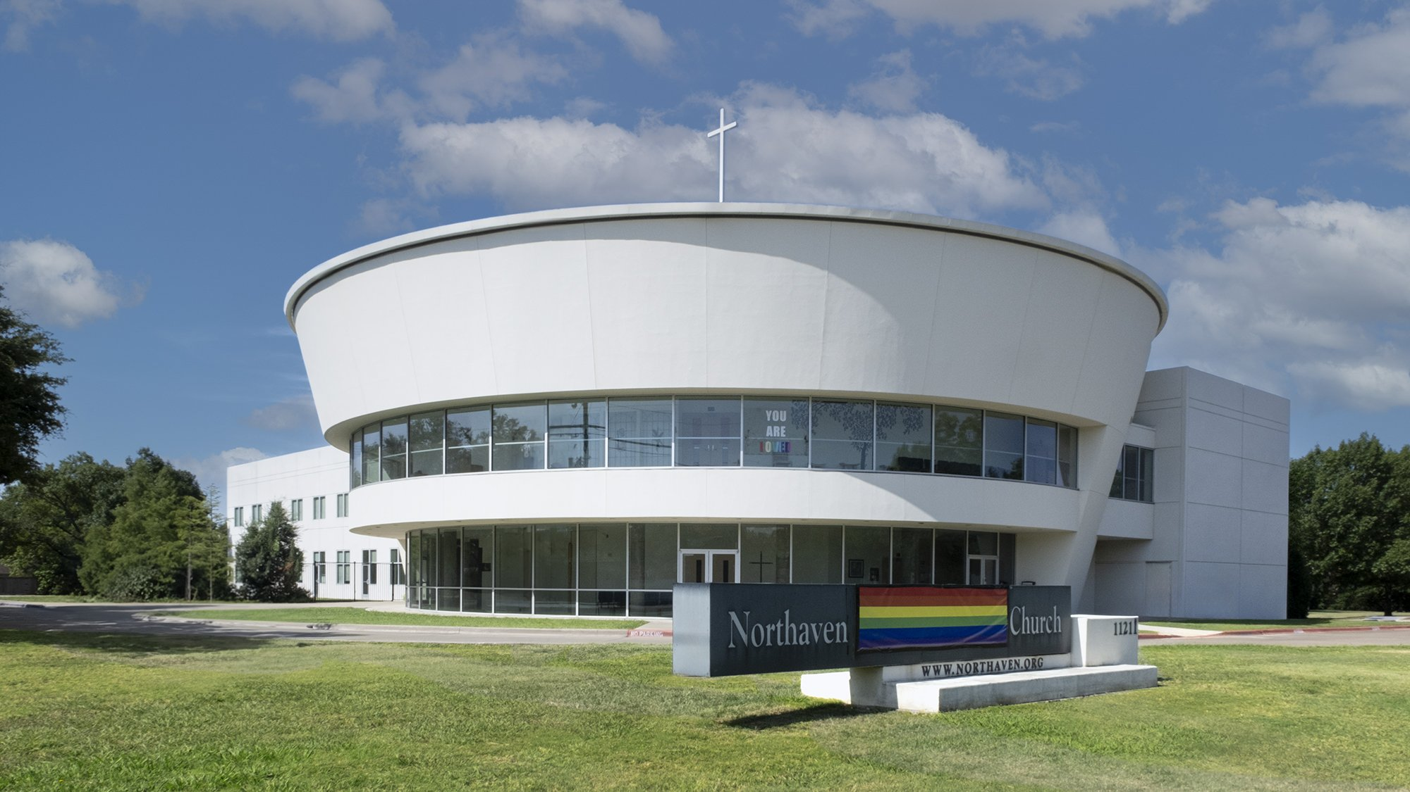
Northaven Church

Slide 4
Farewell to Congregation Shearith Israel
Congregation Shearith Israel (CSI) has been an excellent host facility for meetings of the Dallas Camera Club
The CSI meeting facilities and services set a high standard, difficult to duplicate
CSI has been very generous and flexible in its relationship with DCC
  Staff always welcoming and helpful
  Use of storage space and lobby
  No rent charged during the pandemic
  Additional spaces for training as needed

Slide 5
Northaven Church- Meeting Facilities
Located at 11211 Preston Road, Dallas TX 75230
  Southwest corner of Preston & Northaven Roads
https://www.northaven.org
Parking lots on north and south sides of building
  North parking lot should accommodate most DCC members cars
Building entry on NE corner of building
Do NOT try to enter from south side (location of pre-school)
Meeting Rooms 237 and 239
Elevator and two staircases available to access 2nd floor

Slide 6
Northaven Church- Meeting Facilities (cont.)
DCC Member access to building via north facing door at NE corner of building
Entry to building controlled by access codes to be issued to:
  Jim Walsh- President
  Dennis Fritsche- President-Elect
  Sam Lucas- Competition Director
  David Mann- Membership Director
  Don Haig- House Manager
DCC Membership Director (David Mann or designee) will admit members at North Entry door
After entering building, follow curved hallway to elevator and stairways
Restrooms located on 1st floor curved hallway and 2nd floor near meeting rooms

Slide 7
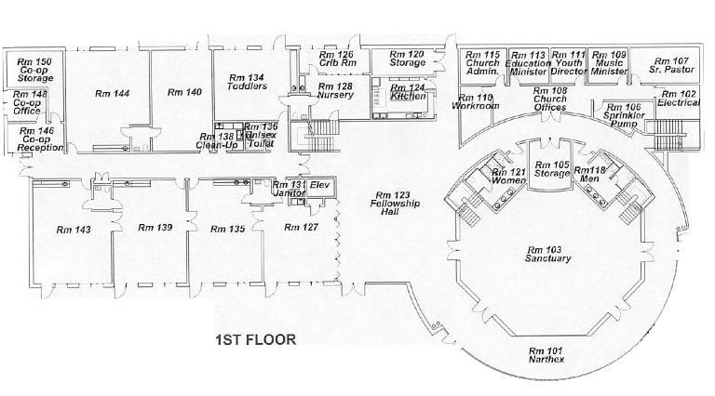
Northaven Church- 1st Floor Plan
North
Stairs
Stairs
Elevator
Restrooms
North Entry

Slide 8
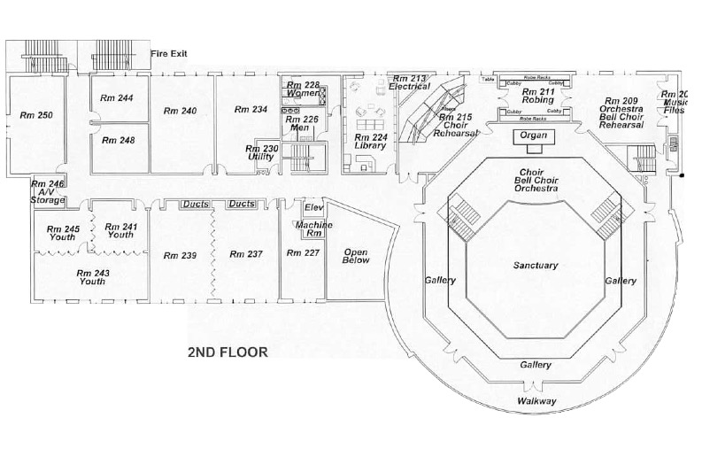
Northaven Church- 2nd Floor Plan
Restrooms
North
Stairs
Stairs
Print Display
Print Display
DCC Meeting Rooms
Training

Slide 9
Moving of DCC Equipment
Desired moving days (awaiting response from Northaven Church)
  Wednesday, Dec. 13
  Thursday, Dec. 14
  Friday, Dec. 15
Utility trailer to be used to transport equipment from CSI
  A/V cabinet
  Cart and storage bins for print display stands
  Library Cart and materials
  Miscellaneous other items
Volunteers: Stephen Evans, Dennis Fritsche, Jerry Martin, Robert Shafer

Slide 10
Q
&
A

