Slide 1
TK8
Why and how to use Luminosity and color Masks

Slide 2
Discount from Tony Kuyper
For a limited time, Tony has extended a 15% discount on the TK8 panels and videos on his website. Use Plano15 at checkout.

Slide 3
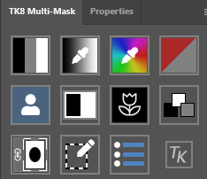
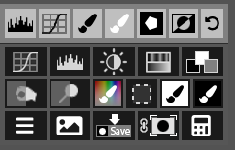
Benefits of Luminosity Masks
Fine control over adjustments when a selection would be difficult
You can adjust the masks with levels, curves, brushes, etc.
Results are very natural-looking. No halos, no abrupt edges, no banding
The masks themselves have shading, so any adjustments are blended
Output to any type of adjustment layer, a selection, channels, or even a pixel layer.

Slide 4
TK8 is actually a suite of plug-ins. Aside from luminosity and color masking, there are a slew of actions available for anything from inserting a new layer, to freehand vignettes, to web sharpening and spotlighting dust. We won’t be going into those, but they are worth checking out!

