Slide 1
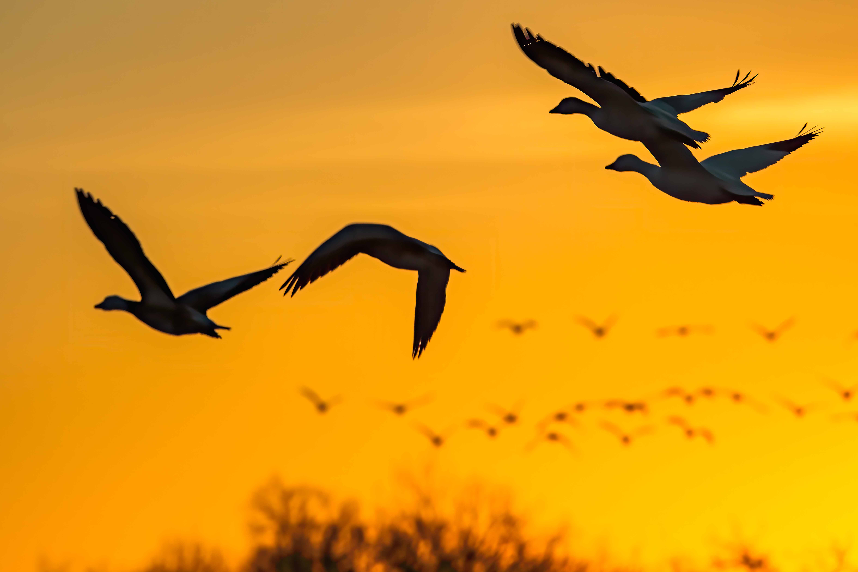
The objective of the Club shall be the mutual entertainment and education of its members in all forms of amateur photographic art.
200830

Slide 2
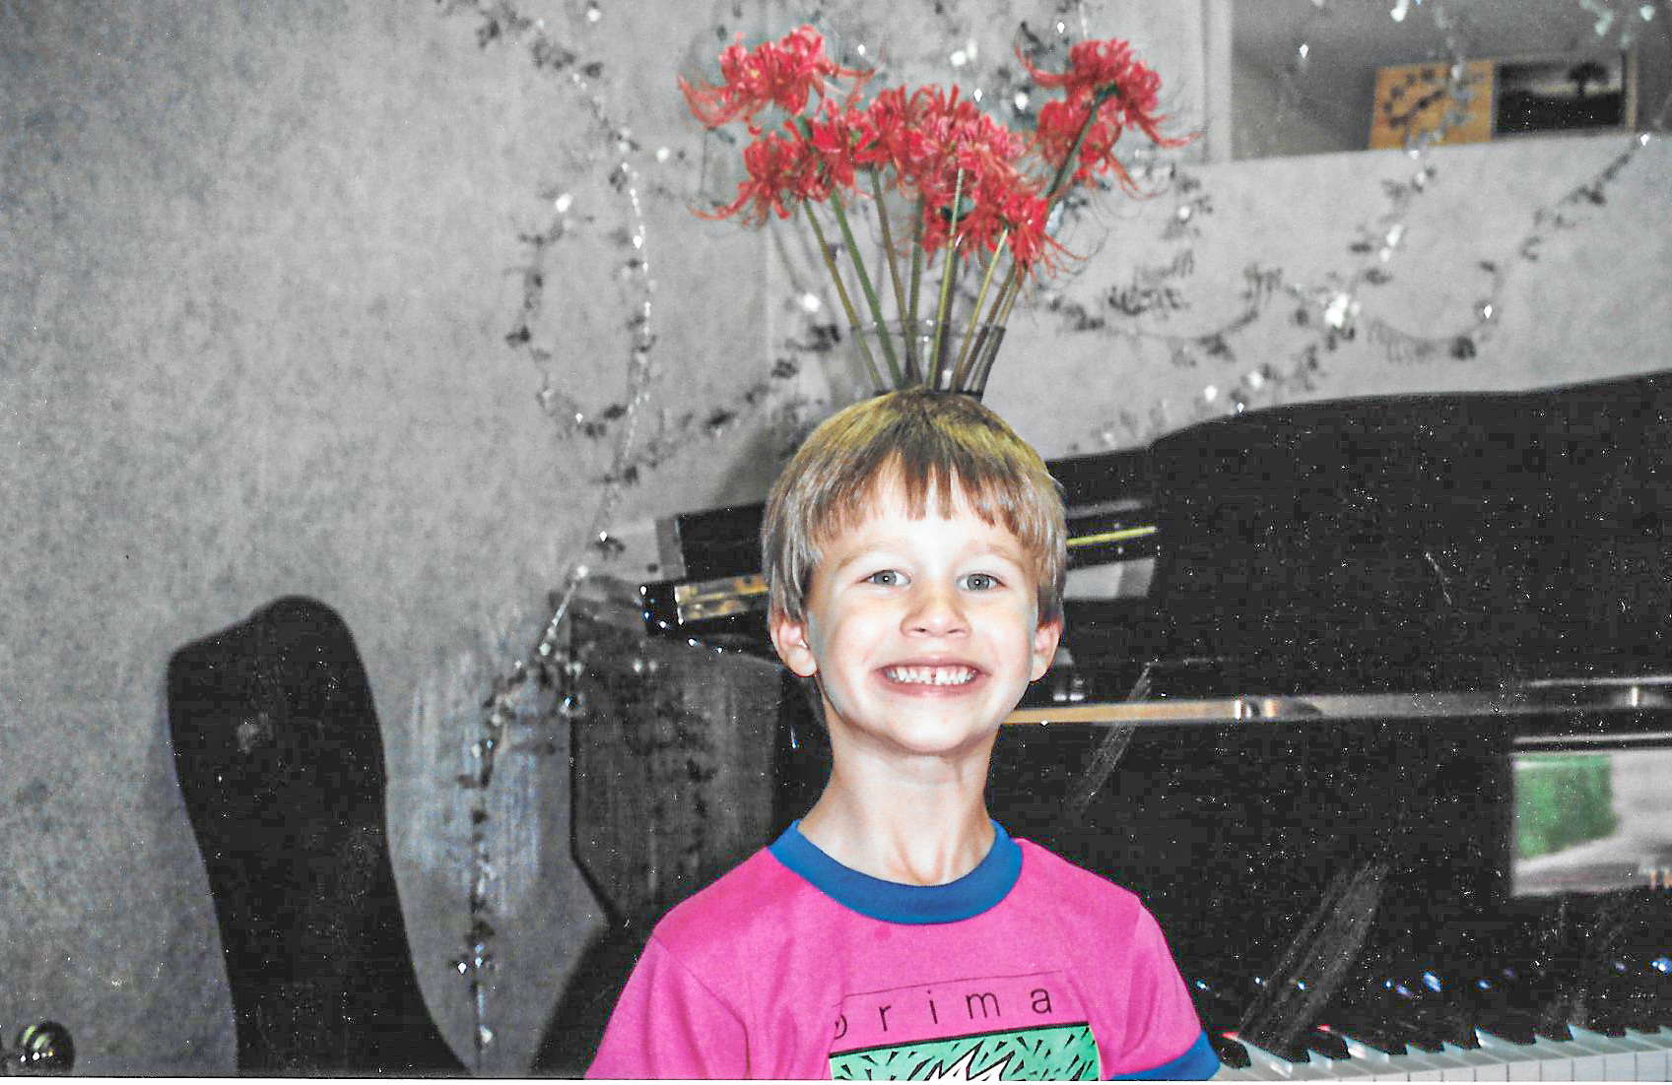
Dallas Camera Club Benefits
Training
Access to experts
Over 20 Master Photographers
Always willing to teach and help
Club leaders and instructors
Classes
Zoom sessions
Classes before in person meetings
Videos archived on the web site
Topics
Beginners/Introduction courses
Cameras/techniques (HDR, Focus Stacking)
Post Processing (Photoshop/Lightroom/etc)

Slide 3
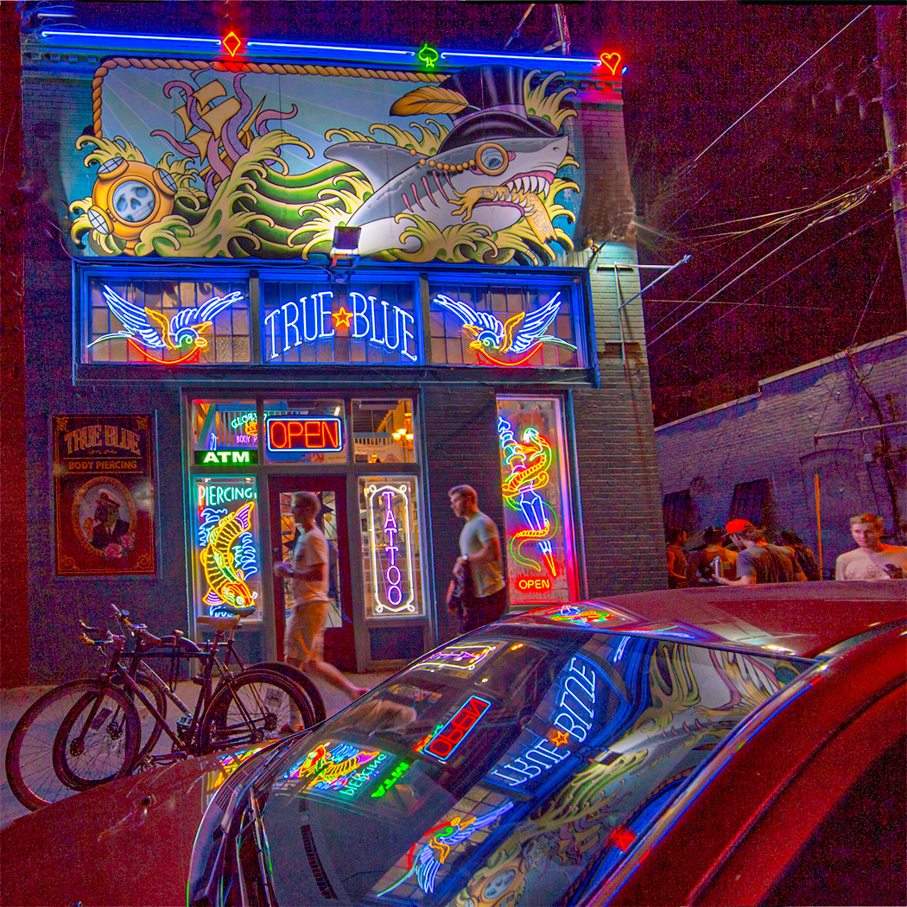
Dallas Camera Club Benefits
Photography Competitions
Why Enter?
Learning Opportunity
Showcase your photography
Monthly Competition
Three classifications
Beginner (Max print size 8.5/11)
Advanced (Max print size 16x20)
Masters (Max print size 16x20)
Three Monthly Categories
Projected Images
Prints – One of few clubs in Texas
Color Prints
Monochrome Prints
Open and Themed Topics

Slide 4
Dallas Camera Club Benefits
Photography Competitions
End of Year Competitions
5 Special competitions
Field Trip
Photojournalism
Contemporary Images
Travel
Creative Portraiture
High Points Awards
Image of the Year – Projected, Color and Mono Prints
Gulf States Council of Camera Clubs
Monthly
Automatic submissions
PSA – Photographic Society of America

Slide 5
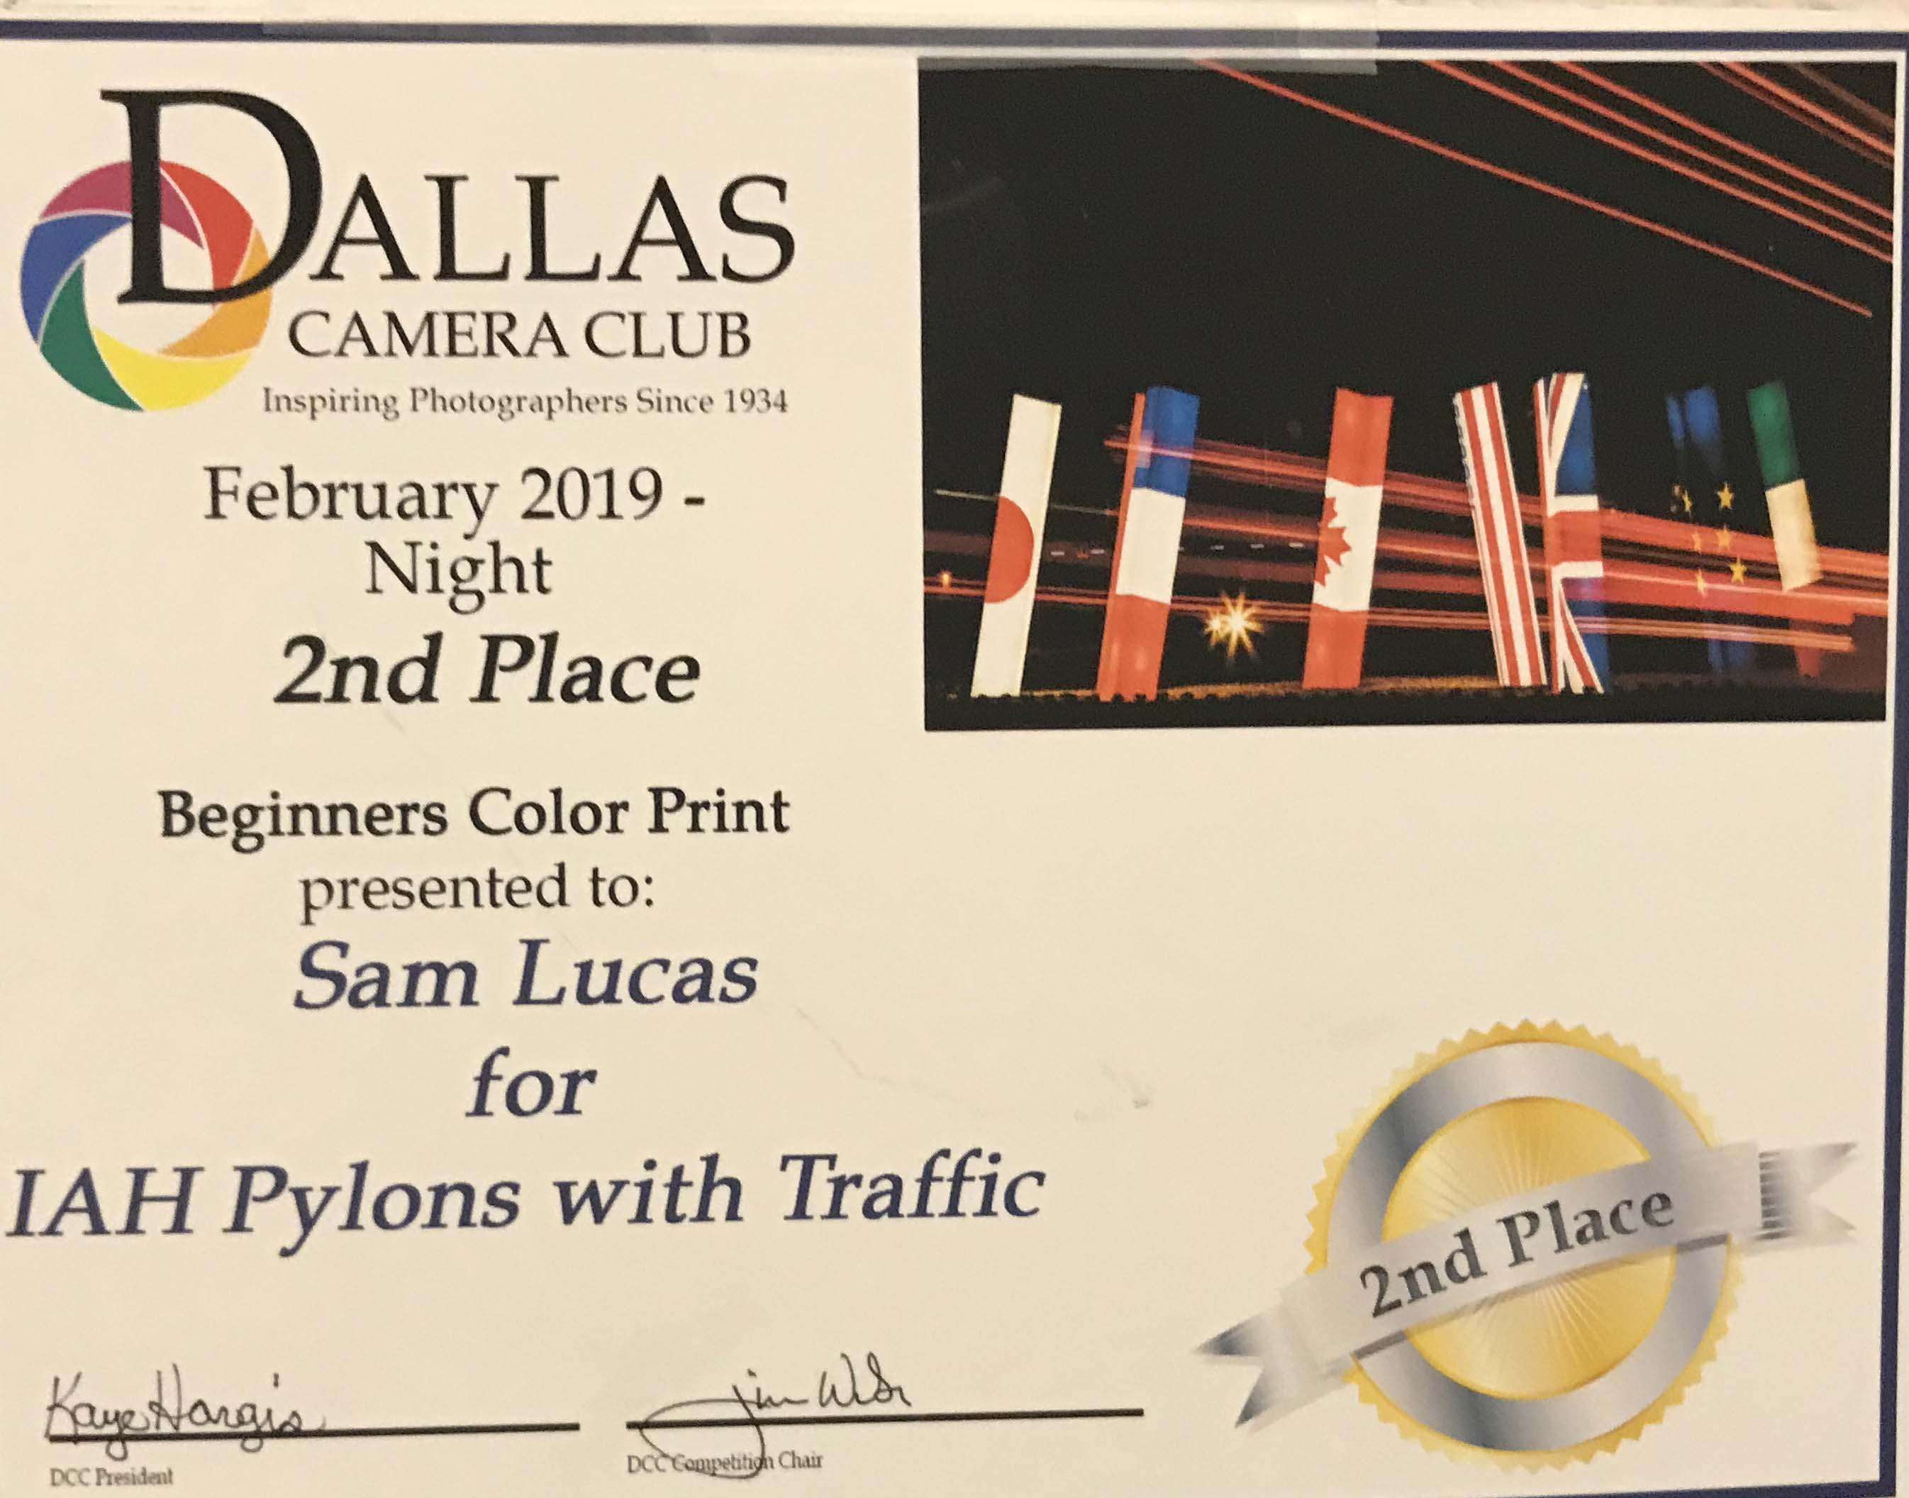
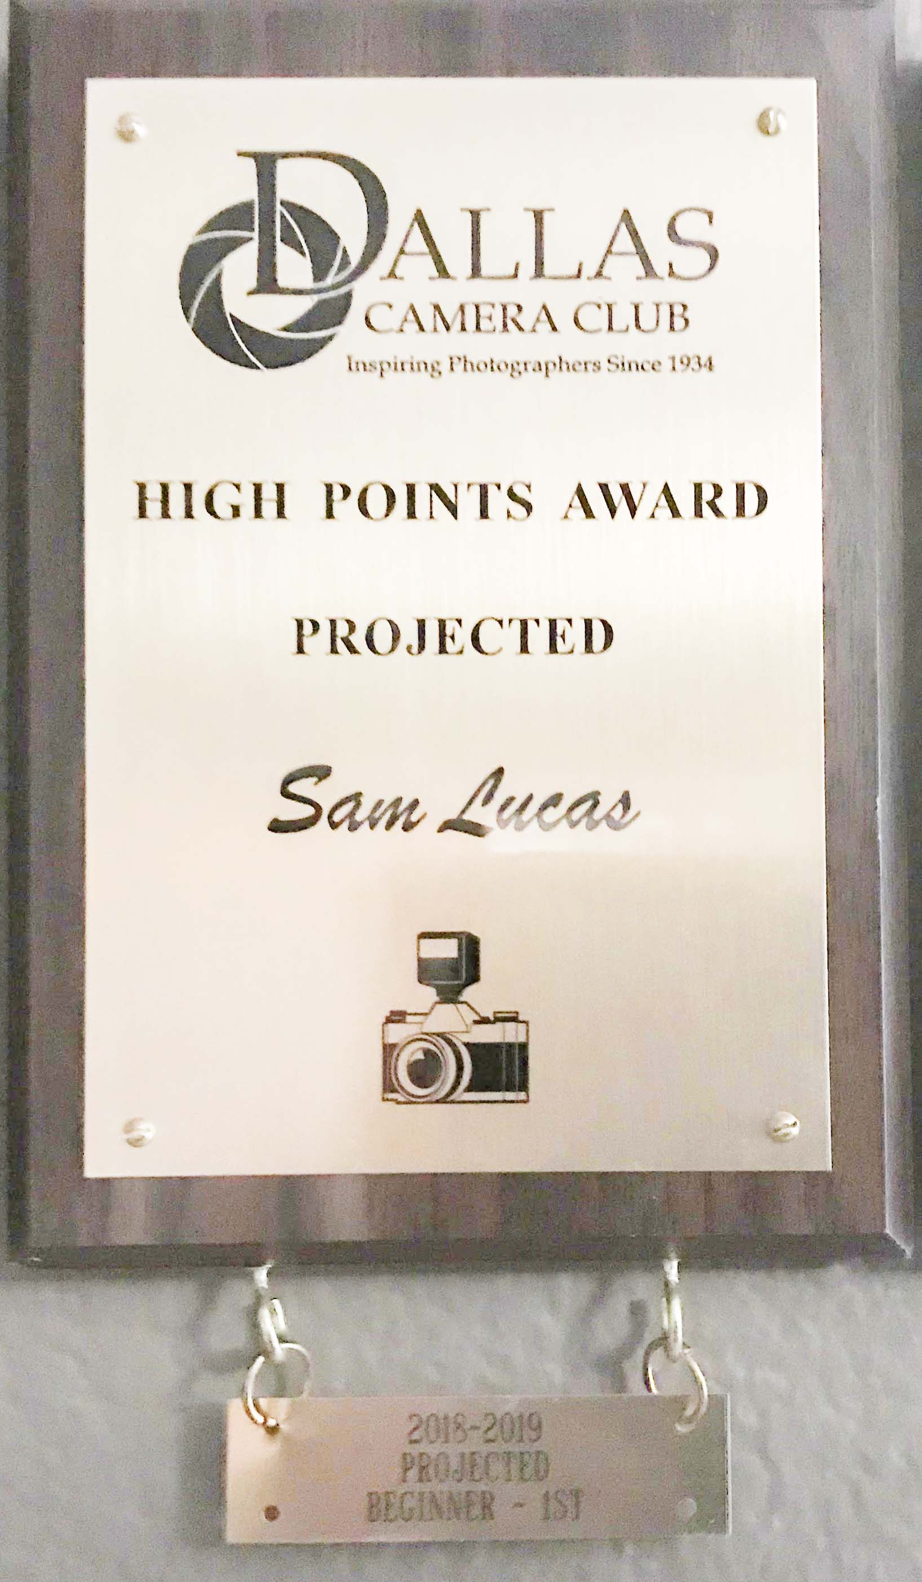
Dallas Camera Club Benefits

Slide 6
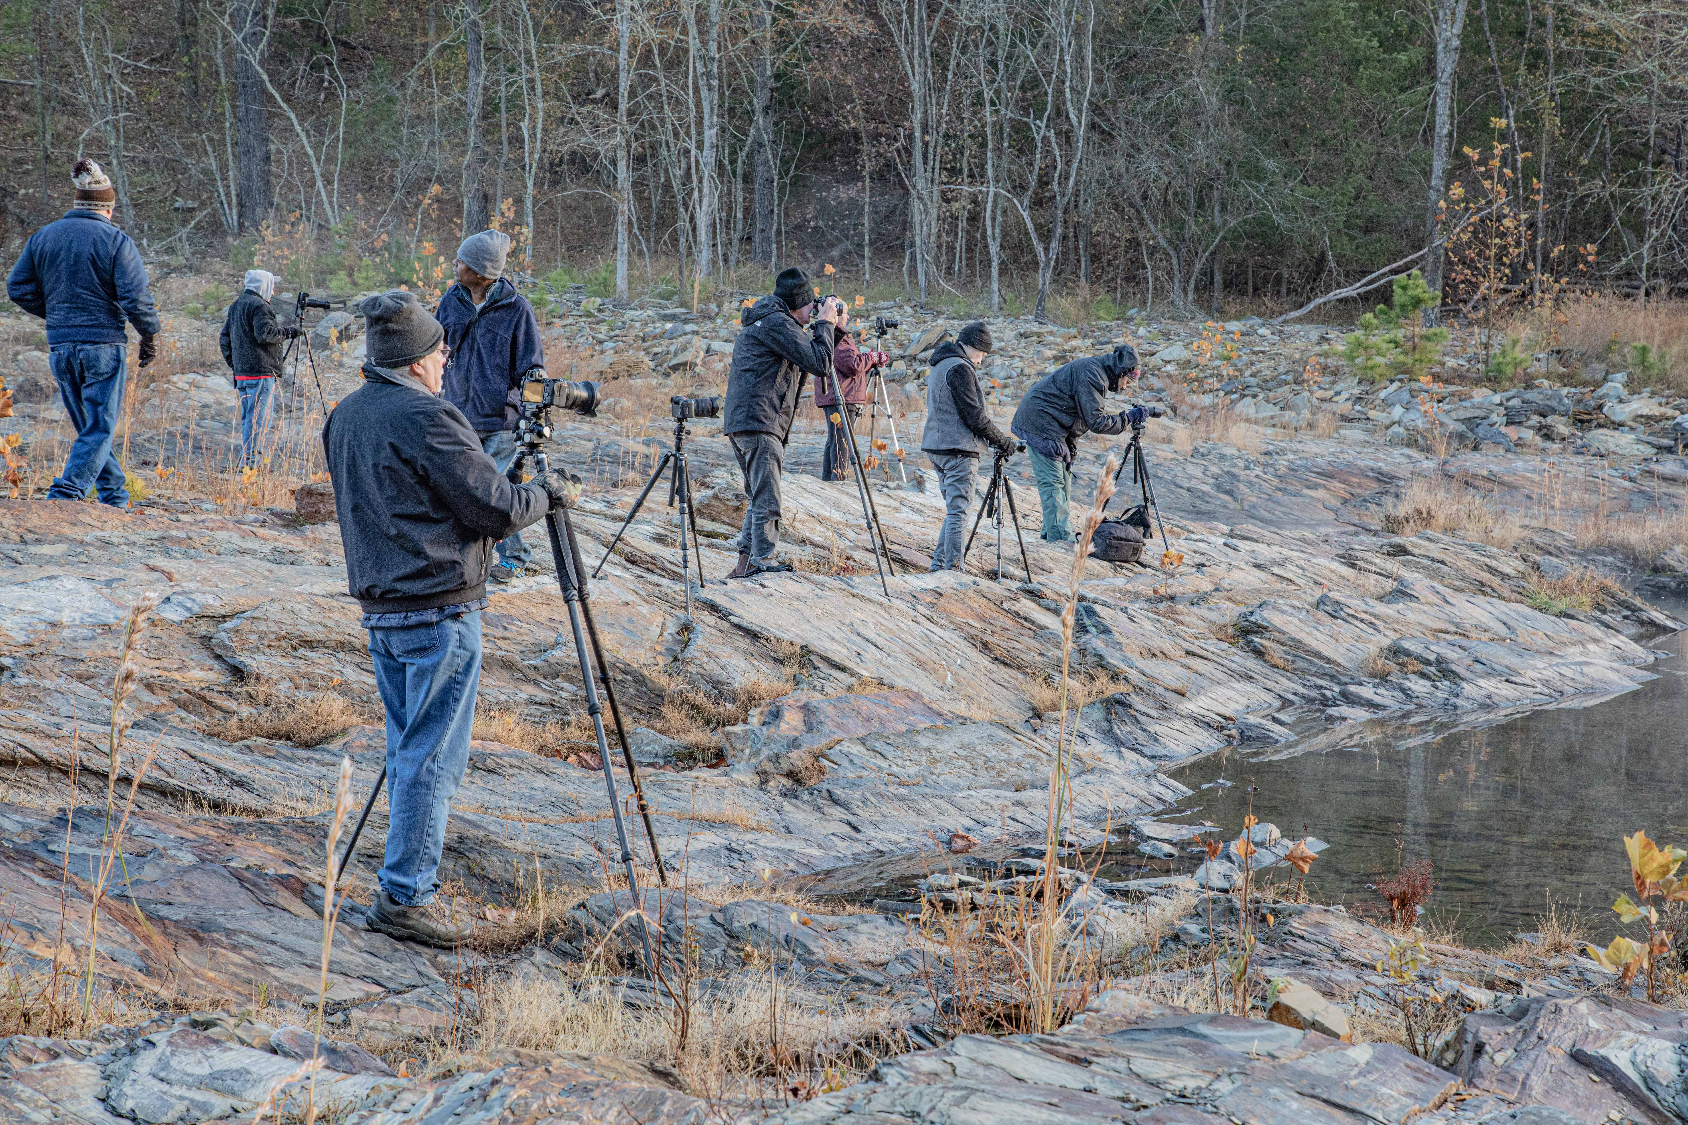
Dallas Camera Club Benefits
Field Trips
Group outings
Conducted Monthly
Local and Out of State
Group meets for lunch/dinner
Self Guided Outings
Photographic Opportunity Inventory
Places to photograph in Dallas
100 Special Architectural Places
Videos

Slide 7
Dallas Camera Club Benefits
Award winning Newsletter
PSA –Best of the Best 2016
Honorable Mention 2019, 2020
Published Monthly
Content
Technical Articles
Recap of club activities
Upcoming activities
Images
Recent competition winners
Image of the Month

Slide 8
Monthly Meetings
2nd Tuesday – Review of monthly competition results
4th Tuesday – Photography related presentation
Zoom for right now
Large spacious meeting facility

Slide 9
The Camera Club Year in Review
The fiscal year of the club is April-March and competition is May through February.
April: 1st meeting: Banquet. Winners from Special Competitions and Images of the Year Winners for all classes. New officers announced. New president discusses his or her plans for new year.
Potpourri – Suggested software: https://photopia.nl/ No judging of shows.
→ Everyone can enter a show. → Show must be self-contained and run by itself
May: 1st meeting: Potpourri Slide Shows presented. Submit first competition of new club year: Subject: Open
June: 1st meeting: Submit first themed competition. Check the website for the topics for the current year.
September: Call for submissions for annual competition with Fort Worth Camera Club (called The Bird, because of Bird Trophy)
October: Normal monthly submissions. Bird competition with Ft. Worth Camera Club.
Dec: Normal monthly submissions. Holiday party. Gift Exchange
February: Final monthly contest for DCC year.

Slide 10
THANK YOU!
Sam Lucas
Phone
(832) 585-6442
Email
SamHoustonLucas@AOL.Com

